Slide 1
Deep Learning
Natural Language Processing (NLP)
LLMs - RAG - Vector Stores – MCP - Agentic AI

Slide 2

Lesson Goals
Fundamentals of LLMs: Students will grasp the fundamentals of LLMs, understand their key components like tokens and tokenization, and explore how they are used.
Word and Sentence Embeddings: Students will explore how text is represented in numerical form through embeddings, distinguish between static and dynamic embeddings, and understand how embedding spaces enable semantic similarity and retrieval.
LLM Families and Parameters: Students will differentiate between various LLM families and understand the function of parameters such as context window, maximum tokens, and temperature.
Uses of a pre-trained LLM: Students will compare different strategies for applying pre-trained language models to downstream tasks, including classical approaches such as fine-tuning, feature-based methods, and prompting as well as newer techniques like instruction tuning and RLHF.
RAG and Vector Databases: Students will learn about RAG and how it addresses the limitations of LLMs, including hallucinations, by using external sources of knowledge.
Agentic AI and MCP: Students will understand how LLMs evolve into autonomous agents through planning, memory, and tool use, and how MCP enables these agents to connect with external tools and data sources.

Slide 3
Introduction From NLP to Agentic AI

Slide 4
From NLP to Agentic AI
Humans naturally acquire and use language as their main means of communication
The goal of NLP is to improve communication
between humans and machines
between humans
NLP enables computers to process, understand, and generate language by learning statistical and structural patterns
Large Language Models (LLMs) have revolutionized NLP by learning rich representations of meaning and context from vast amounts of text
These models power Generative AI, enabling systems that can produce coherent, context-aware text, images, and other content
Notes:
Natural language is the primary medium through which humans communicate, and we begin acquiring it from infancy. It is therefore natural to aspire to use language as a means of interaction with machines. Natural Language Processing (NLP) refers to the computational processing of human language with the aim of enabling understanding and generation of text. This involves capturing the patterns and structures inherent in language and representing them through statistical and probabilistic models.

Slide 5
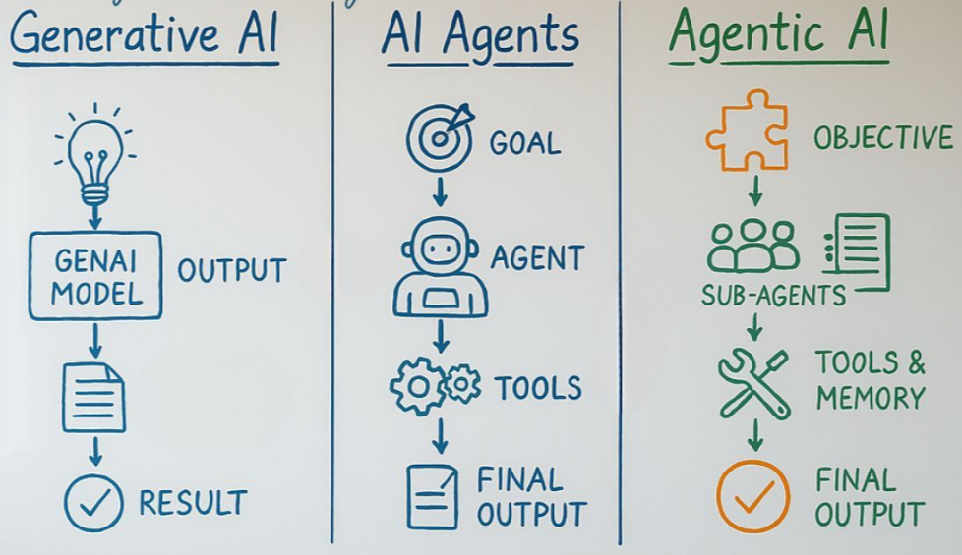
From NLP to Agentic AI
Retrieval-Augmented Generation (RAG) extends LLMs with access to external knowledge, reducing hallucinations and improving factual accuracy
Agentic AI builds upon LLMs and RAG by adding reasoning, planning, memory, and tool use, turning passive models into autonomous, goal-directed systems
Yet, open challenges remain: current systems still lack true understanding, grounding, and common sense comparable to human cognition
Notes:
Recent advances in agentic AI have brought us closer to this goal, allowing language to serve as a powerful and intuitive interface between humans and machines. However, while such systems can model and respond to language with impressive fluency, they do not yet possess true understanding or grounded meaning in the human sense. Thus, although we have achieved language as an effective interface, the deeper cognitive and semantic comprehension of natural language remains an open challenge.

Slide 6
Large Language Models
LLMs

Slide 7
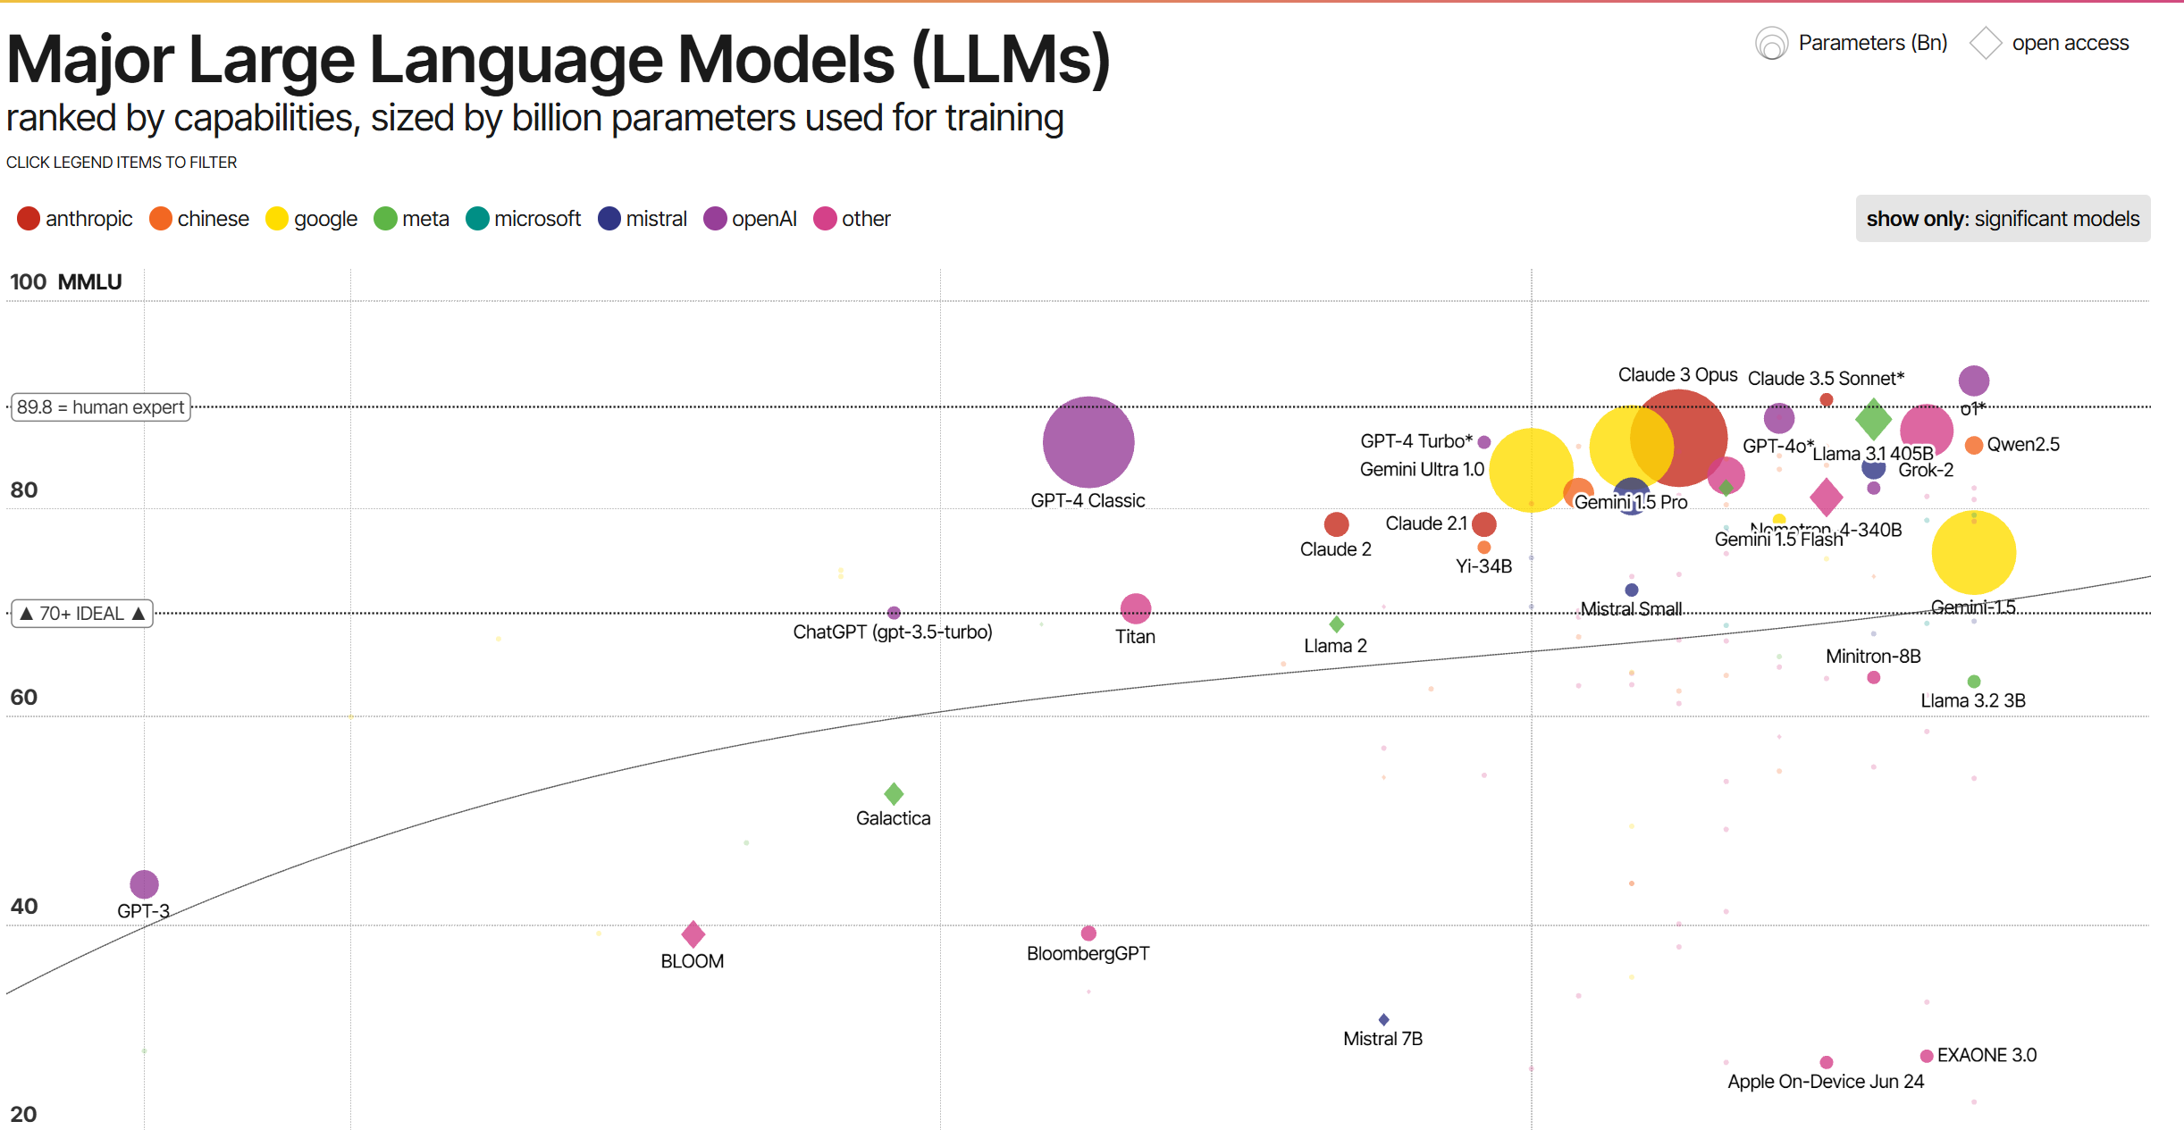
Notes:
https://informationisbeautiful.net/visualizations/the-rise-of-generative-ai-large-language-models-llms-like-chatgpt/
When people say ‘AI’ these days, they usually mean an LLM — GPT (OpenAI), BERT (Google), Claude (Anthropic), LLaMA (Meta), Mistral (Mistral (Europe), etc. These are all different implementations of the same basic idea: a model that has learned the patterns of language so thoroughly that it can generate meaningful text about almost any topic.

Slide 8
General idea of LLM
Language has become the interface between humans and machine through large language models or LLMs
An LLM is a deep neural network that predicts the next word in a sequence based on patterns learned from vast amounts of text e.g.,
LMs can use different neural architectures, but LLMs are typically based on the transformer architecture
Transformers use self-attention and feedforward layers to model complex relationships in text
Once upon a ___
Notes:
Language has become the interface between humans and machines. Now we’ll look under the hood of the systems that make that possible: Large Language Models, or LLMs.
A large language model (LLM) is a deep neural network trained on vast amounts of text. It learns the statistical patterns of language and uses this knowledge to predict the most likely next word or sequence based on context.
Text from books, Wikipedia, scientific papers, code, and social media.
How? Context, language patterns (syntactic and semantic word relations),

Slide 9
General idea of LLM
An LLM learns many different syntactic and semantic relationships between words, concepts, and ideas
It represents words as numerical vectors, where each dimension corresponds to a specific relationship or linguistic feature
The result is an embedding space that captures meaning
Words and sentences with similar meanings are located close together within this space
Notes:
Example syntactic and example semantic relationship

Slide 10
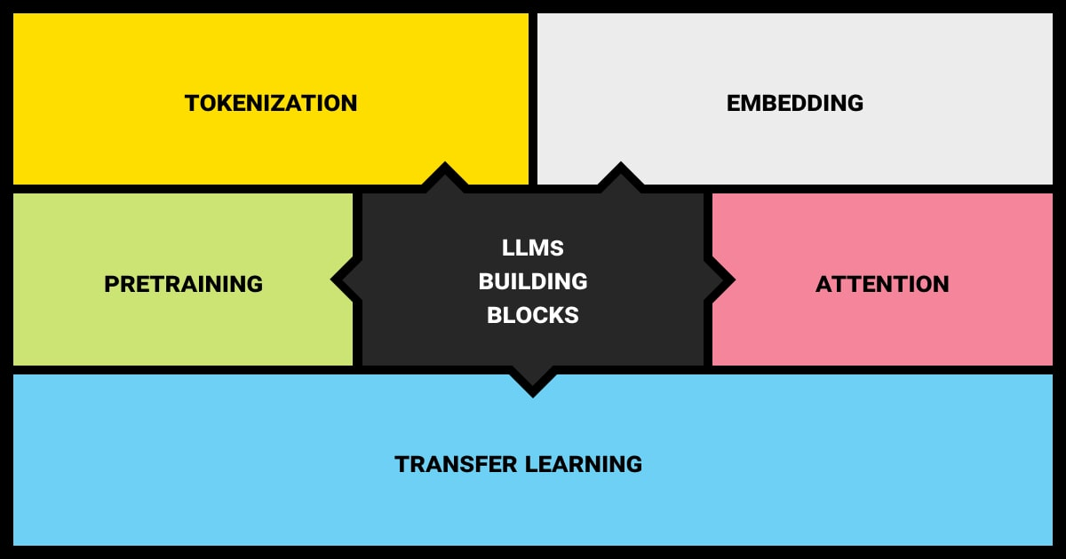
LLMs building blocks (next lessons: deep dive into these parts)
Notes:
https://labelyourdata.com/articles/llm-fine-tuning/types-of-llms

Slide 11
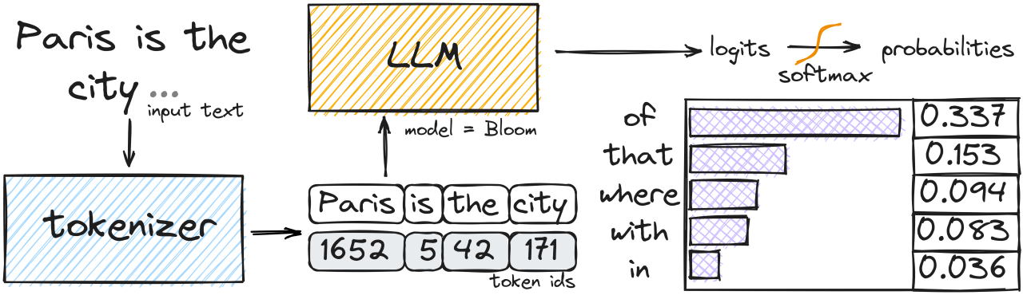
LLMs building blocks (next lessons: deep dive into these parts)
Notes:
https://www.linkedin.com/pulse/how-exactly-llm-generates-text-ivan-reznikov/

Slide 12
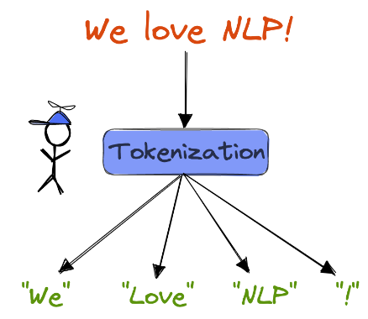
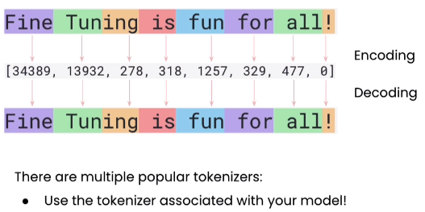
Tokenization
Tokenization is the process of translating strings (i.e. text) and converting them into sequences of tokens and vice versa
Notes:
Difficult for some languages (see next lecture)
ID in vocabulary, one-hot encoded vector

Slide 13
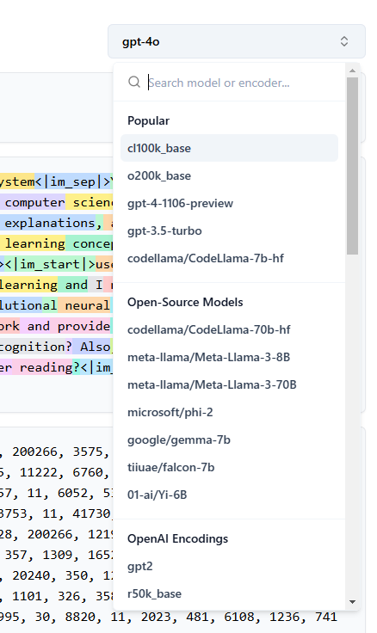
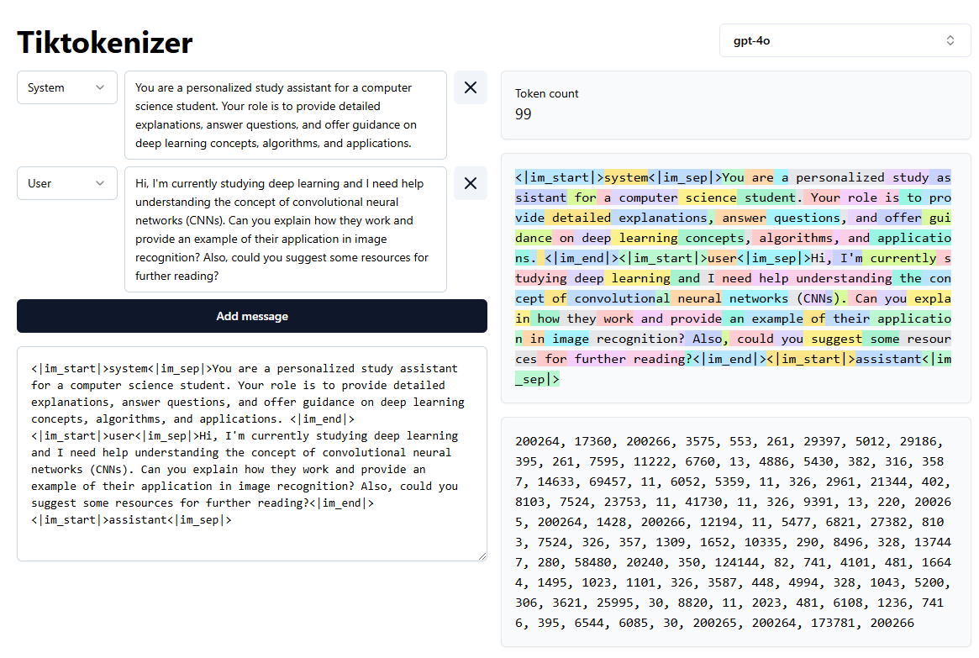
Tokenization https://tiktokenizer.vercel.app/

Slide 14
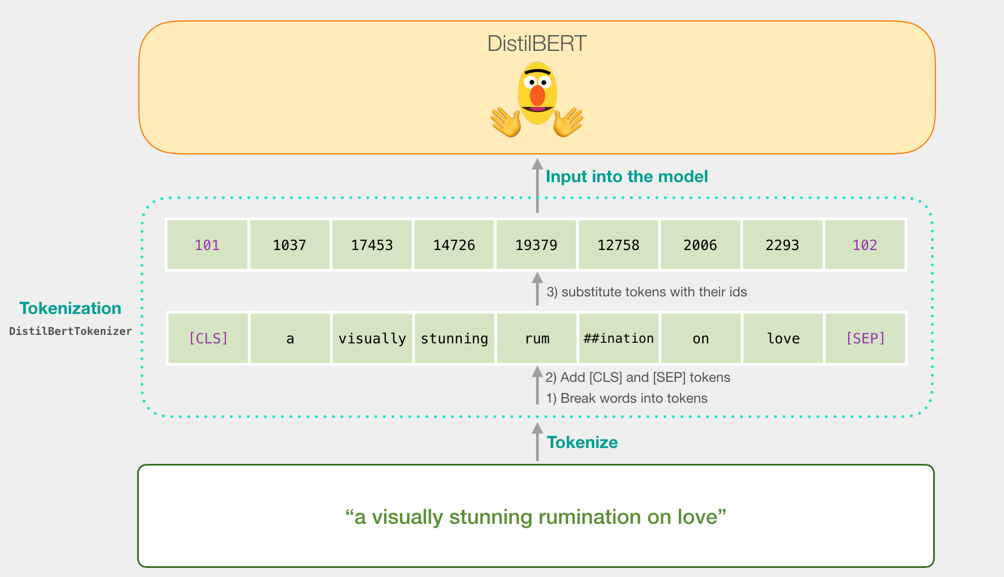
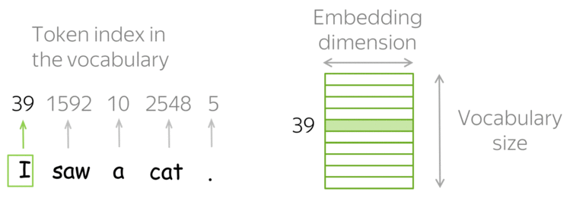
Tokenization and Vectorization
Notes:
Subword-level

Slide 15
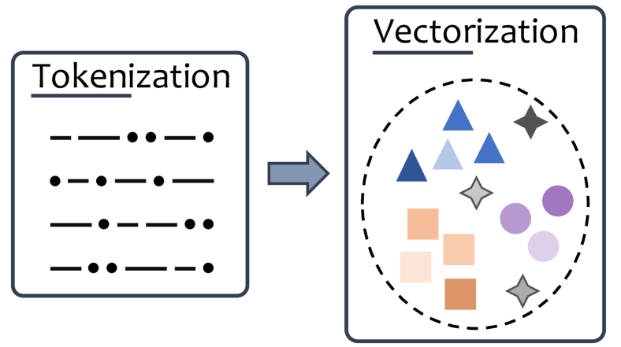
Tokenization and Vectorization
The LLM starts with a token embedding layer, which maps discrete tokens (via one-hot encoding) to continuous embedding vectors
In each transformer block these embeddings are refined and contextualized so that they capture patterns useful for prediction
Notes:
The first layer turns tokens into embeddings. As the model trains, it updates those embeddings so that they capture patterns useful for prediction
The model starts with a token embedding layer, which maps discrete tokens (via one-hot encoding) to continuous vectors.
As the input passes through each transformer block, these embeddings are refined and contextualized through self-attention mechanisms and feedforward layers.

Slide 16
Word Embeddings
Embeddings are numerical representations of meaning learned automatically by the model during training
Embeddings emerge naturally during training
Embeddings form the foundation of everything an LLM does, that is, understanding, reasoning, retrieving, generating, and comparing text
The model learns to predict the next word To do that well, it must understand how words relate to context That understanding becomes encoded as vectors in the model’s internal layers

Slide 17
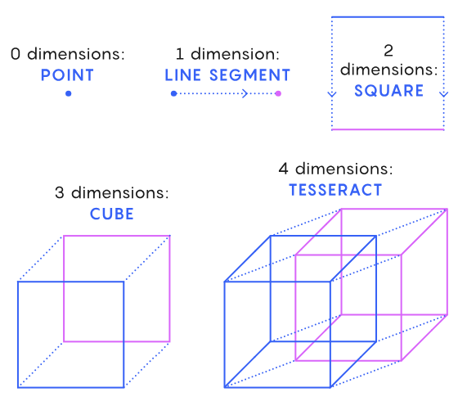
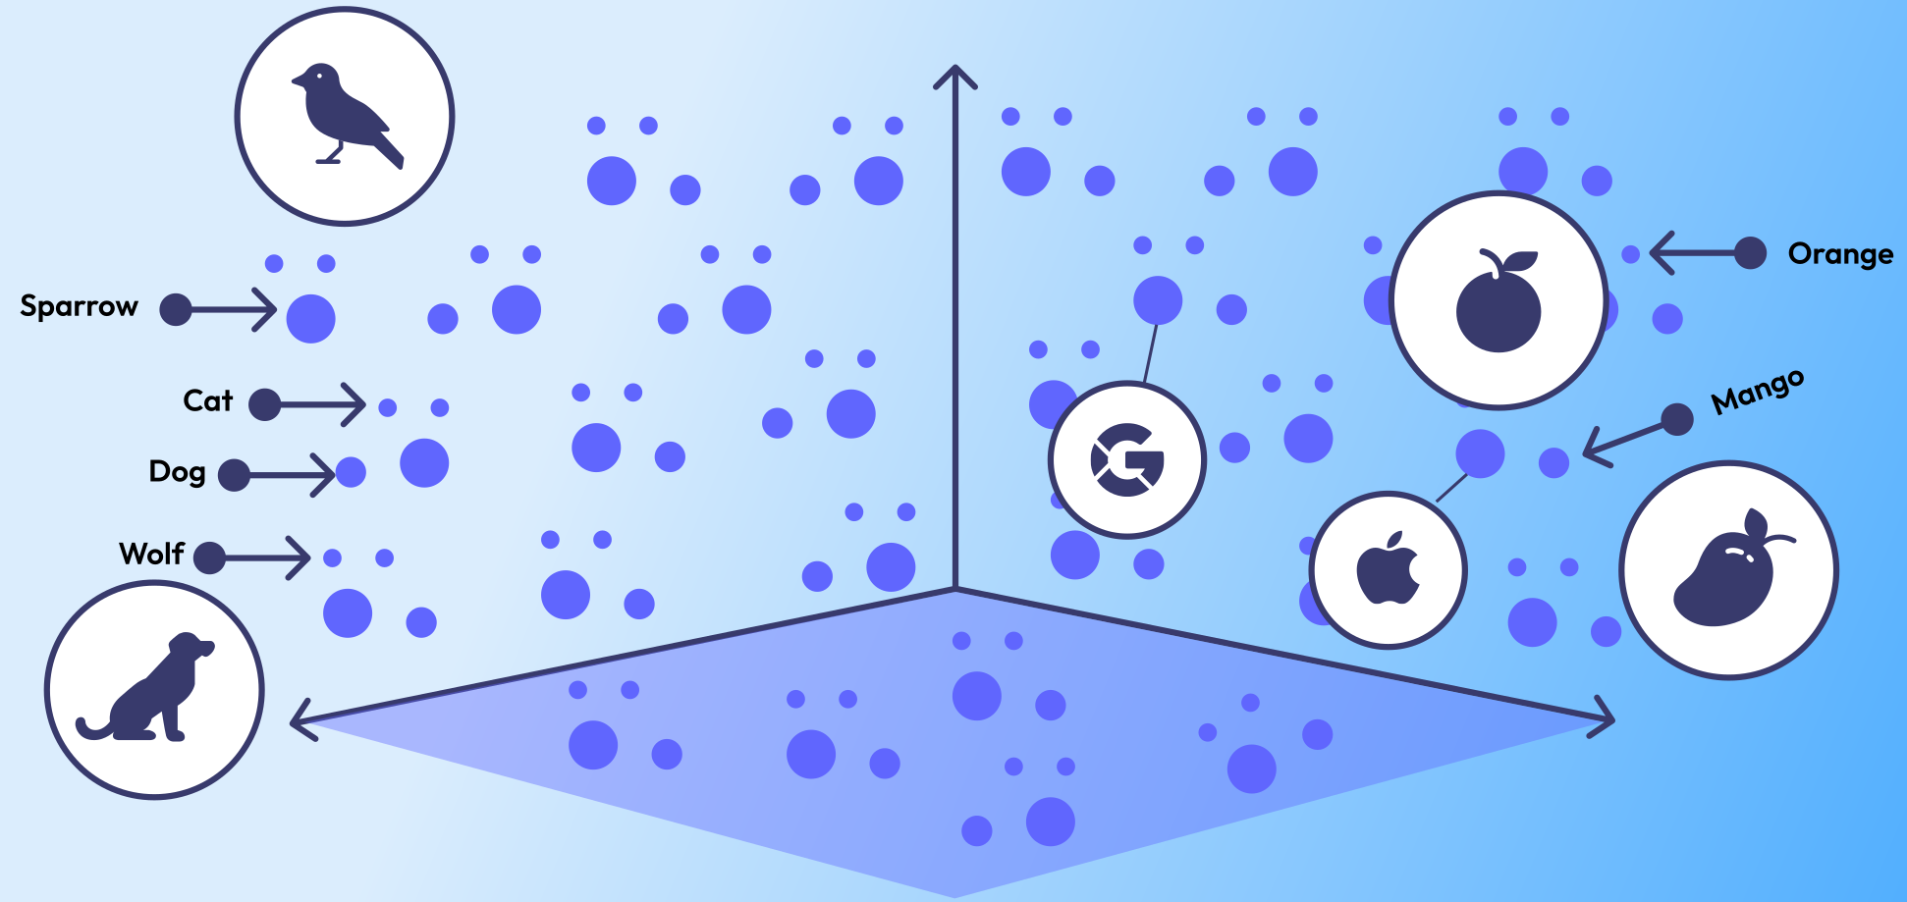
Word Embeddings
The goal of embeddings is representation learning, that is, finding a way to represent words in a continuous numerical space so that the geometry reflects meaning
Notes:
Words, sentences, documents are data points/vectors in a high-dimensional space and the cosine similarity/euclidean distance represents the semantic similarity between the data points
Each word, sentence, or paragraph is mapped to a point (a vector) in this continuous numerical space. The position of that point encodes semantic relationships — closeness in space means similar meaning.
Cosine similarity, Euclidean distance
Each dimension corresponds to a specific relationship or linguistic feature (plural nouns, animalness)

Slide 18
Latent Space
The continuous numerical space of embeddings is called the latent space because:
It represents the hidden, internal structure of language and meaning that the model discovers during training
Each dimension encodes certain linguistic or semantic features, but these features are not labeled or interpretable in a human-readable way
Inside an LLM, embeddings exist at every layer
Each layer produces its own latent space which is a unique internal representation of language at that stage of processing
Feature extraction can be done at different layers depending on what kind of information you want
Notes:
Latent means hidden
In other words, the model learns its own private coordinate system for language, one that reflects meaning geometrically, even though we can’t point to an axis and say what it stands for.
Early layers capture surface-level or syntactic features (like word forms, positions, and grammar).
Middle layers encode contextual and relational meaning (which words depend on each other, sentence structure).
Deeper layers represent abstract semantics and task-specific meaning (intent, tone, topic, reasoning patterns).

Slide 19
Word Embeddings: Static or Dynamic
Context-independent
(e.g., Word2Vec, GloVe)
One embedding per word, regardless of how it is used
Precomputed and fixed/static
E.g., the word ‘bank’ has the same vector in ‘river bank’ and ‘bank account’ even though the meanings differ
Context-dependent (e.g., BERT, GPT, modern LLMs)
Different embeddings depending on the surrounding context
Computed and updated dynamically
E.g., the vector of ‘bank’ changes depending on whether the nearby words suggest finance or geography

Slide 20
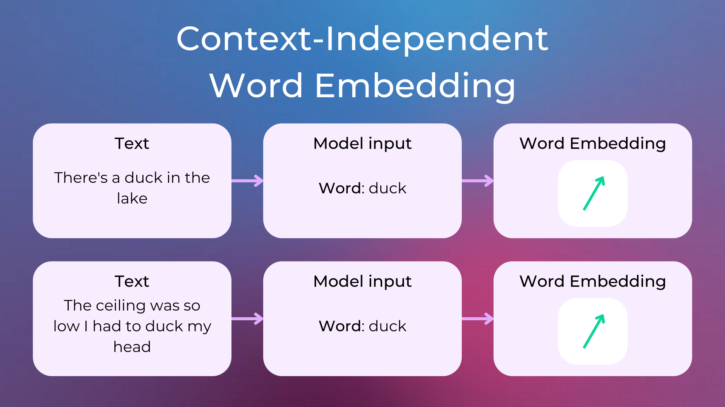
Notes:
https://www.nlplanet.org/course-practical-nlp/01-intro-to-nlp/11-text-as-vectors-embeddings

Slide 21
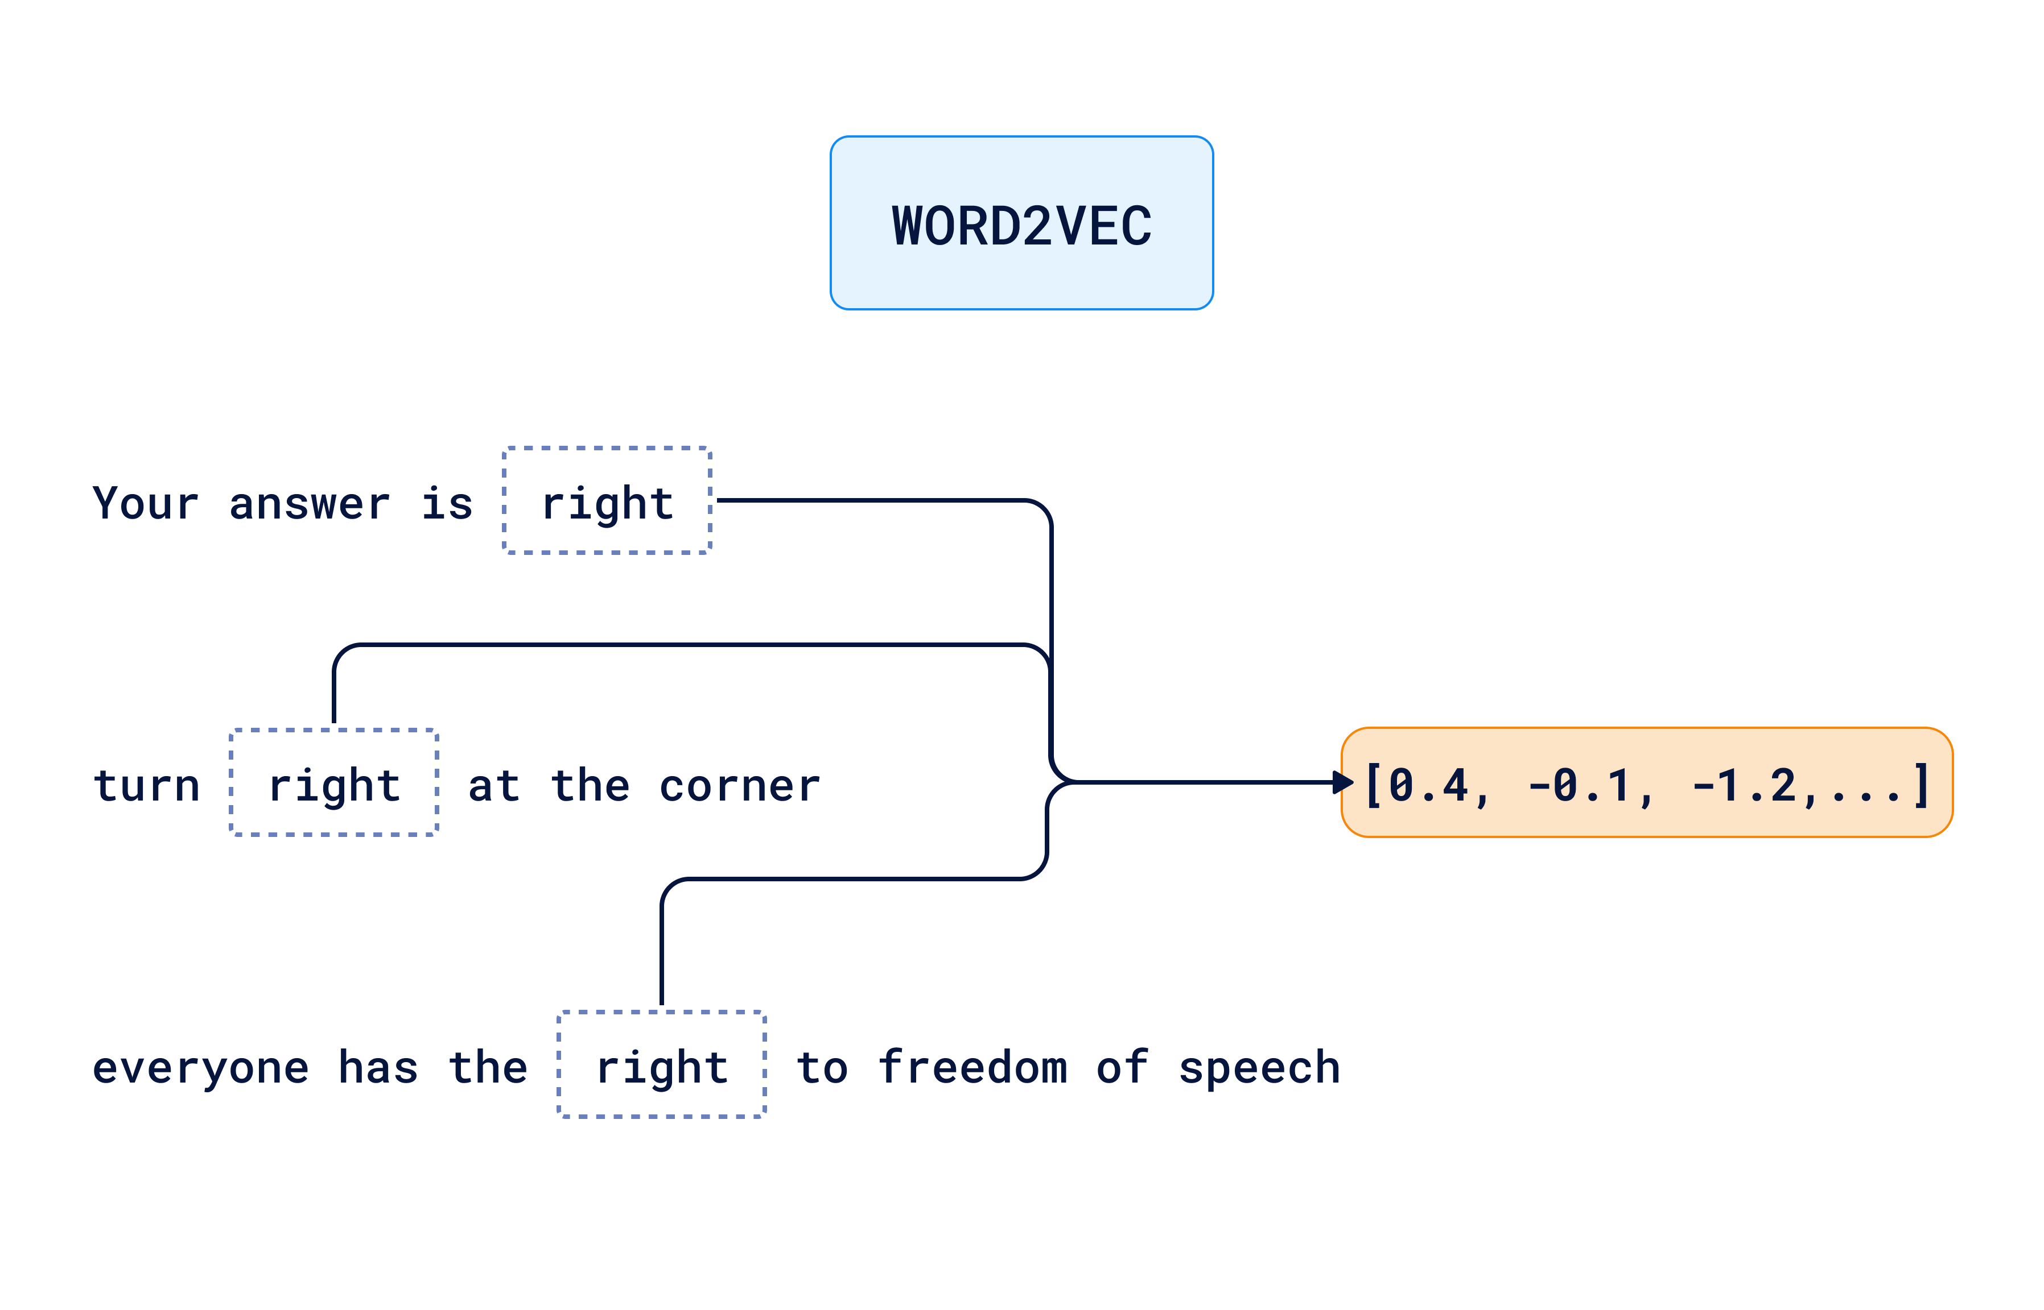

Slide 22
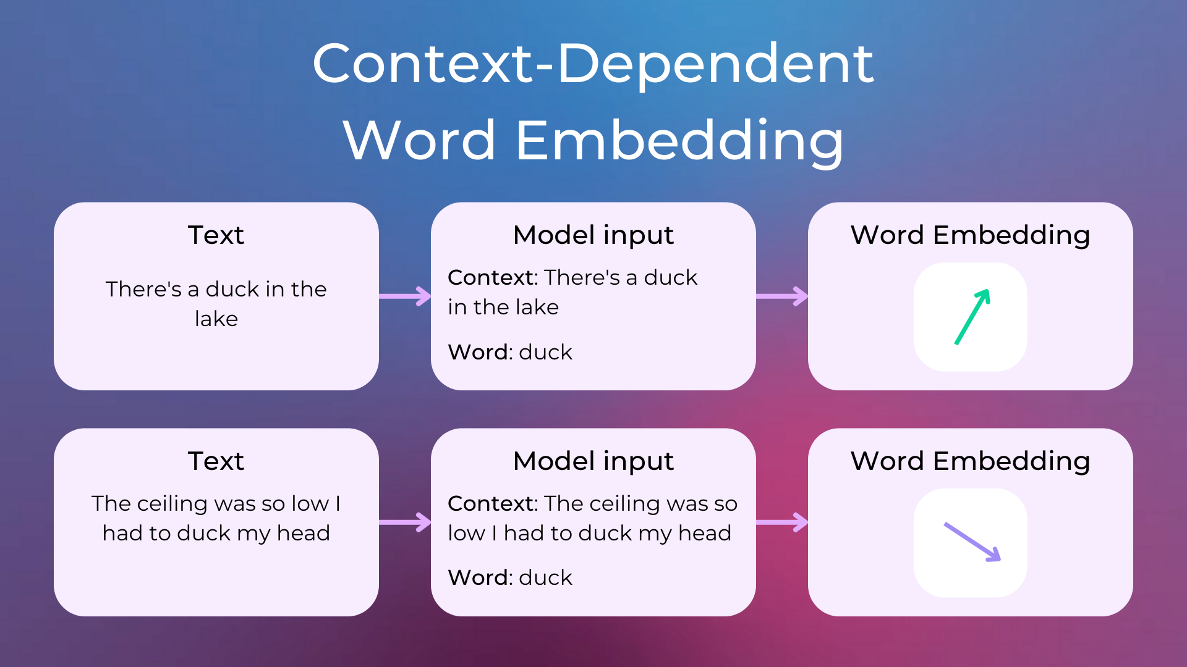
Powered by
LLM

Slide 23
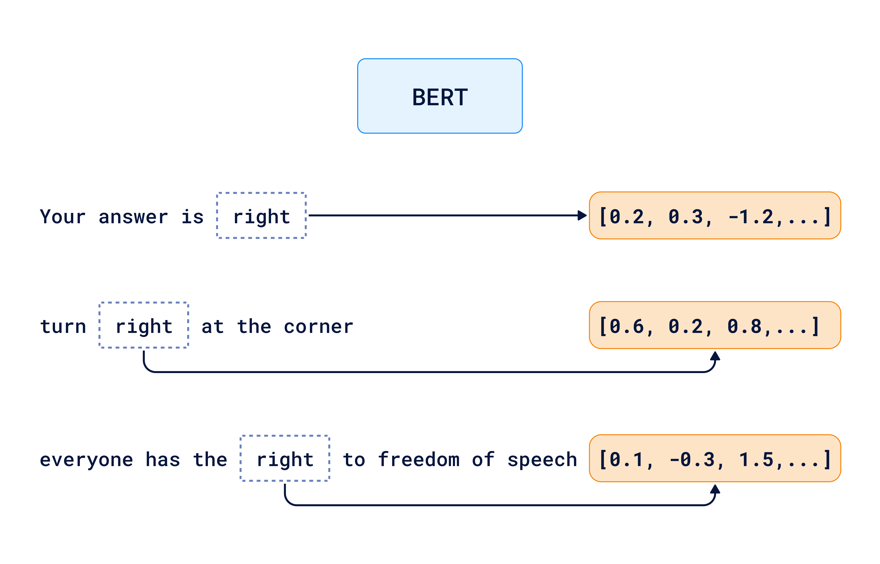

Slide 24
Sentence embeddings
We can create embeddings at different levels:
Token embeddings: individual words or subwords
Sentence embeddings: a vector representing an entire sentence’s meaning
Document embeddings: a vector aggregating meaning of longer texts
In RAG systems, we often use sentence or paragraph embeddings to search for relevant chunks of text by meaning
Notes:
So it is important to have semantic representations of sentences

Slide 25
Sentence embeddings
To get a sentence embedding we need to combine the contextual token embeddings, e.g., by averaging or pooling
However, this produces sentence embeddings that are:
Unstable: The same sentence can map to a different point in the embedding space dependent on context, order, or batch
Not-comparable: The geometry of the space is not necessarily meaningful, that is, the relative positions of two sentence embeddings do not reliably correspond to their semantic similarity
Notes:
Or CLS-token, see next lecture
But the model was not trained to make those combined vectors comparable across sentences.
But there is no guarantee that averaging or pooling them produces a consistent, semantically aligned representation across different sentences. In other words, The relative positions of two sentence embeddings in space don’t reliably correspond to their semantic similarity, while semantically similar sentences should be close together, and dissimilar ones far apart
In general-purpose LLMs like GPT or BERT, sentence embeddings can vary slightly depending on the batch because normalization, padding, and numerical precision are computed relative to other inputs. This means the same sentence may map to a slightly different point in the embedding space, making its vector representation unstable and not directly comparable across runs or contexts.

Slide 26
Embedding models
Embedding models are not general-purpose LLMs but specialized variants trained to produce stable, comparable embeddings for sentences
E.g., OpenAI text-embedding-3, Cohere Embed, SentenceTransformers
They are trained by fine-tuning a general-purpose LLM (e.g. GPT, BERT) on semantic similarity datasets (pairs of similar/dissimilar sentences)
Embedding models produce semantic sentence embeddings that are context-dependent, sentence-level, and task-agnostic, meaning they can be used reliably for search, clustering, and retrieval
Notes:
Specialized embedding models take the most meaningful layers and fine-tune them for semantic similarity, giving us fixed vectors we can use for search, clustering, and retrieval tasks.
Why external APIs provide their own “embedding models”
When you use APIs like OpenAI’s text-embedding-3, Cohere Embed, or SentenceTransformers, those aren’t the same models as ChatGPT or GPT-4 — they are specialized variants trained specifically to produce stable, comparable embedding vectors.
Here’s why that matters:
In a general-purpose LLM, embeddings are constantly shifting as the model processes tokens in context.
For tasks like semantic search or vector databases, you need fixed-size, context-aware, comparable embeddings — so that two sentences with similar meaning map to vectors that are close in space.
So, embedding models are typically:
derived from an LLM (e.g. from GPT, BERT, or similar),
fine-tuned on semantic similarity datasets (e.g. pairs of sentences labeled as similar or dissimilar),
optimized using contrastive objectives (e.g. cosine similarity between meaning-equivalent texts should be high).
The result is that:
“I love dogs” and “I really like puppies” → embeddings are close.
“I love dogs” and “The car needs fuel” → embeddings are far apart.
These embeddings are context-dependent, sentence-level, and task-agnostic, meaning they can be used reliably for search, clustering, and retrieval.
Sentence Transformers (sbert) provides embedding models with a dimension n in the range of 384, 512 and 768, and the models are completely free and open-source.
OpenAI and Cohere embeddings, which require a paid API call to generate them, can be considered higher quality due to a dimensionality of a few thousand. One reason it makes sense to use a paid API to generate embeddings is if your data is multilingual (Cohere is known to possess high-quality multilingual embedding models that are known to perform better than open source variants).

Slide 27
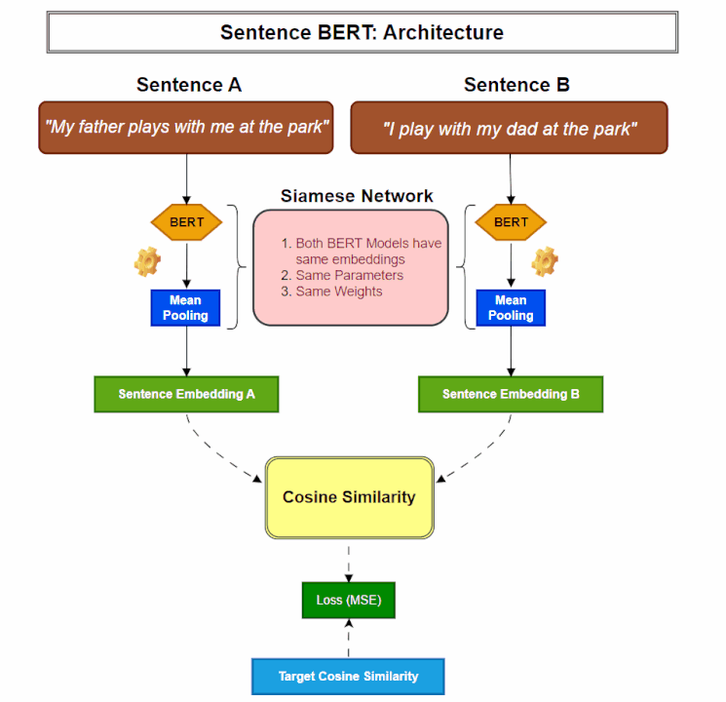
Notes:
https://medium.com/@vipra_singh/building-llm-applications-sentence-transformers-part-3-a9e2529f99c1
Regression, could also use a triplet loss

Slide 28
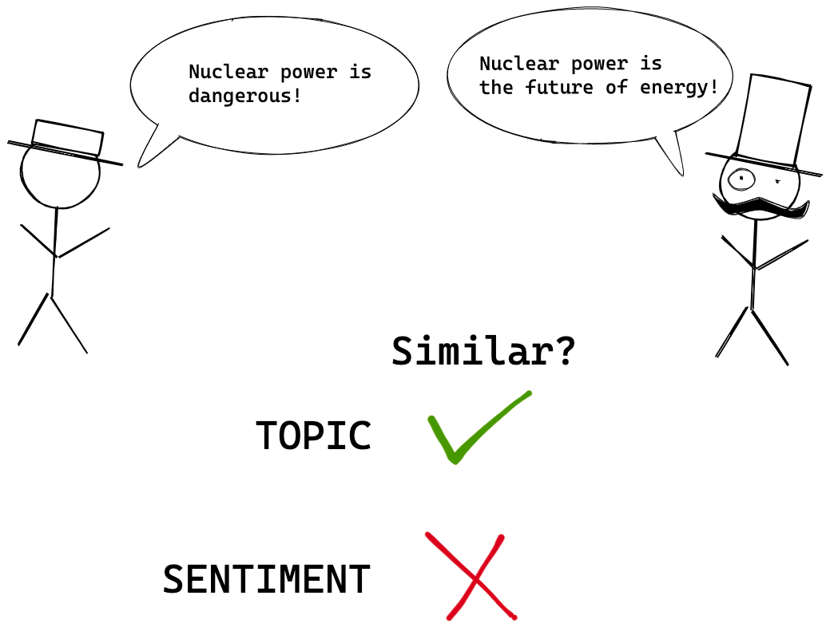
Embedding models
Two sentences can be similar in multiple ways, e.g., topic, sentiment, tone, paraphrasing, …
When building systems like RAG we usually want topical similarity
Notes:
https://blog.ml6.eu/decoding-sentence-encoders-37e63244ae00
Two sentences can be similar in multiple ways — for example:
Topical similarity: they discuss the same subject. → “Cats are great pets.” / “Dogs make wonderful companions.”
Sentiment similarity: they express the same attitude or emotion. → “I love this movie.” / “That film was fantastic.”
Stylistic or syntactic similarity: they use similar phrasing or grammar. → “The experiment was successful.” / “The project was completed successfully.”
Functional or pragmatic similarity: they serve the same communicative purpose. → “Can you pass the salt?” / “Would you hand me the salt?”
Different embedding models may emphasize different kinds of similarity some capture topic better, others capture sentiment or paraphrasing. When building systems like RAG or search, you usually want semantic or topical similarity — sentences about the same concept, not necessarily those with the same tone or structure.

Slide 29
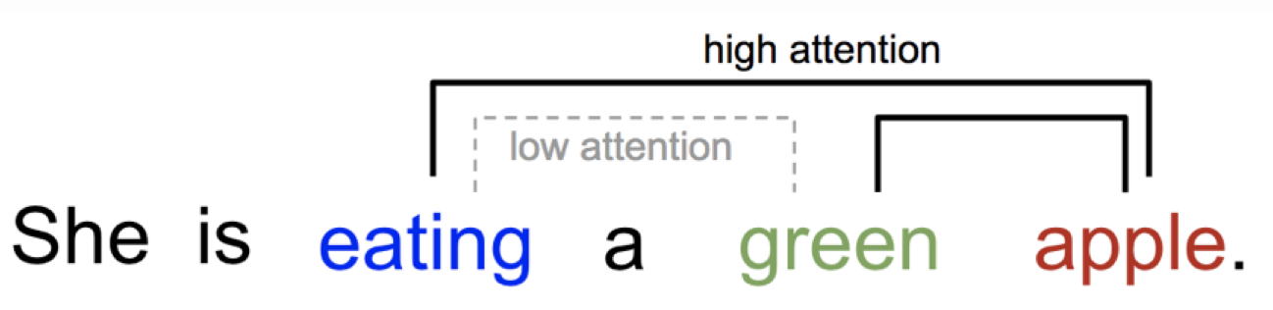
Self-attention
In psychology, attention is the cognitive process of selectively concentrating on one or a few things while ignoring others
Self-attention is when attention is performed between tokens of the same sequence
It refines or contextualizes the embedding of a word by considering the embeddings of related words in the sentence
It is applied through multiple heads and layers, allowing the model to capture different kinds of relationships from nearby syntactic links to longer-range semantic dependencies and overall context
Notes:
Attention mechanism in neural networks is an attempt to implement the same action of selectively concentrating on a few relevant features while ignoring others
Different word relations can be captured, e.g object of a verb, adjective of a noun
Early layers capture surface-level or syntactic features (like word forms, positions, and grammar).
Middle layers encode contextual and relational meaning (which words depend on each other, sentence structure).
Deeper layers represent abstract semantics and task-specific meaning (intent, tone, topic, reasoning patterns).
Lower level layers learn low-level word features,
e.g., recognition of subwords such as “-ing” or “un-”, part-of-speech tagging such as noun, verb, adjective Higher level layers learn high-level word features,
e.g., word meaning depending on context, long-range dependencies, metaphors, abstract concepts With multi-head self-attention an LLM learns word features that are suitable for a wide variety of NLP tasks

Slide 30
Transfer Learning
Traditional NLP models were task-specific: each model was trained from scratch on a small dataset
Transfer learning flips this idea:
Train a model once on a large, general corpus (e.g., books, web text)
Then adapt or fine-tune it for many downstream tasks (e.g., classification, QA, summarization)
This “transfers” language understanding from general training to specific tasks
Modern LLMs (e.g., GPT, LLaMA) are massively pretrained using self-supervised objectives such as next word prediction
These models learn universal linguistic and semantic patterns
They serve as general-purpose foundations: one model, many tasks
Notes:
These models learn universal linguistic and semantic patterns: syntax, meaning, reasoning, discourse

Slide 31
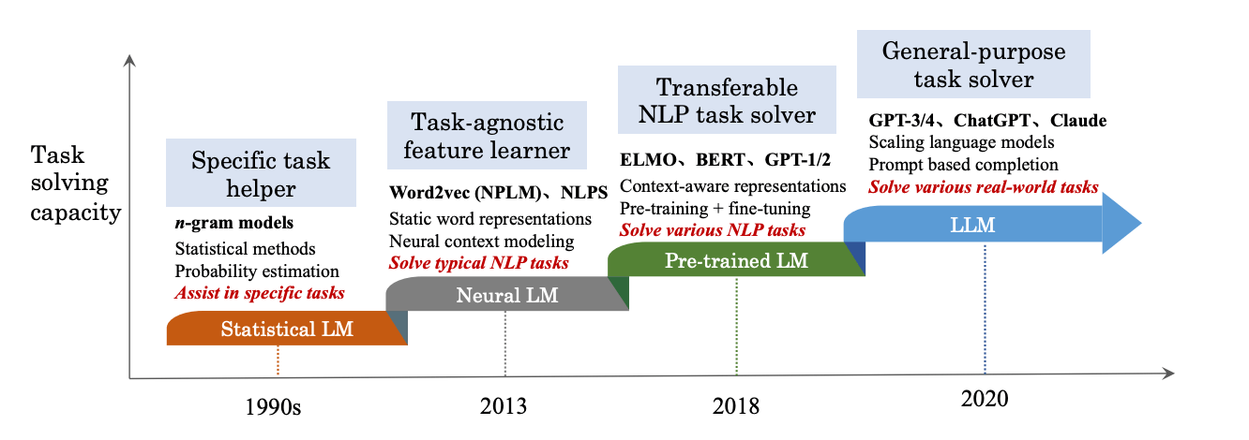
Evolution of Language Models
Notes:
https://klu.ai/glossary/large-language-model

Slide 32
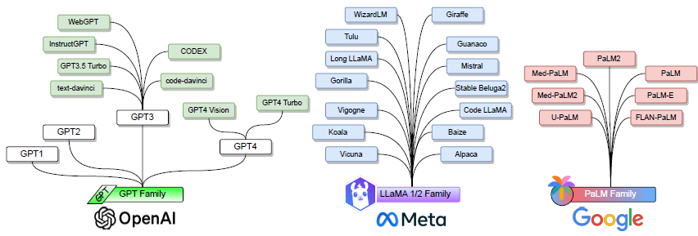




LLM Families (pre-trained models)
LLaMa:
Open Source

Slide 33
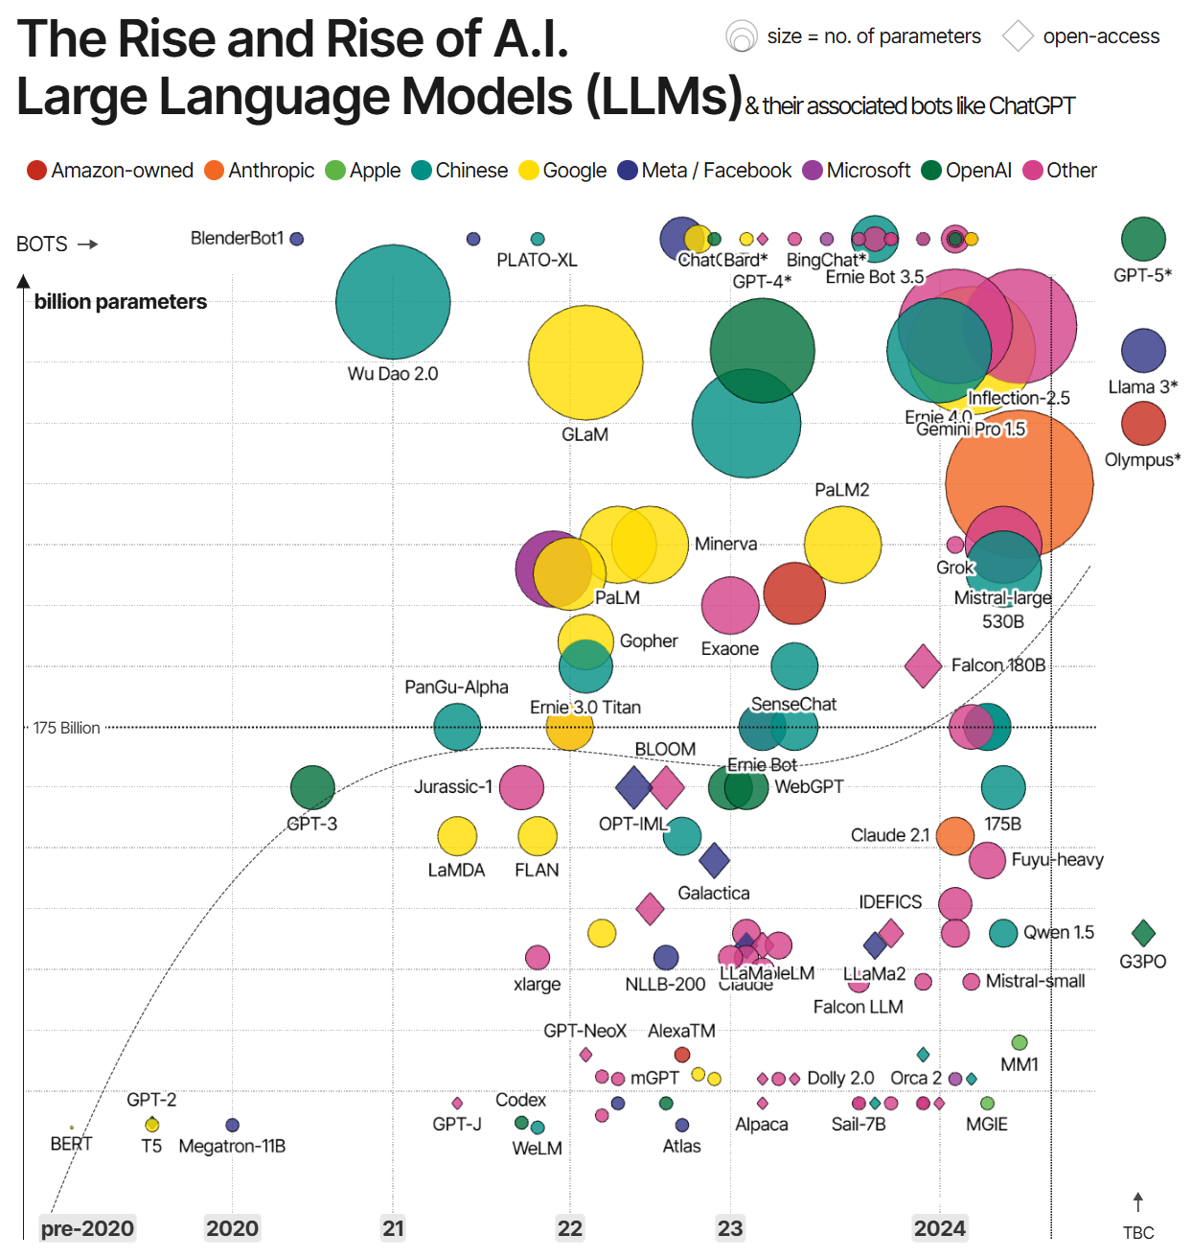
Notes:
https://informationisbeautiful.net/visualizations/the-rise-of-generative-ai-large-language-models-llms-like-chatgpt/

Slide 34
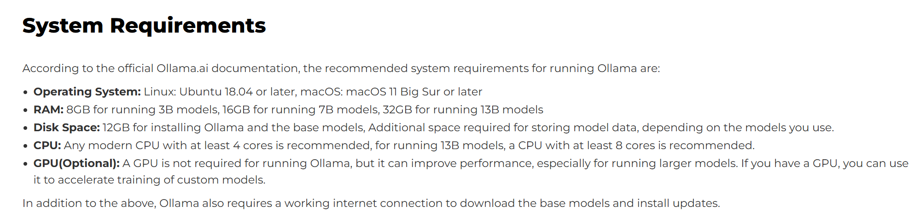
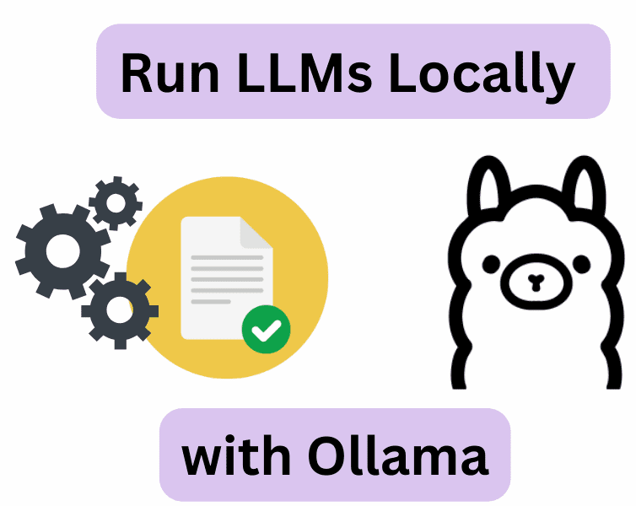
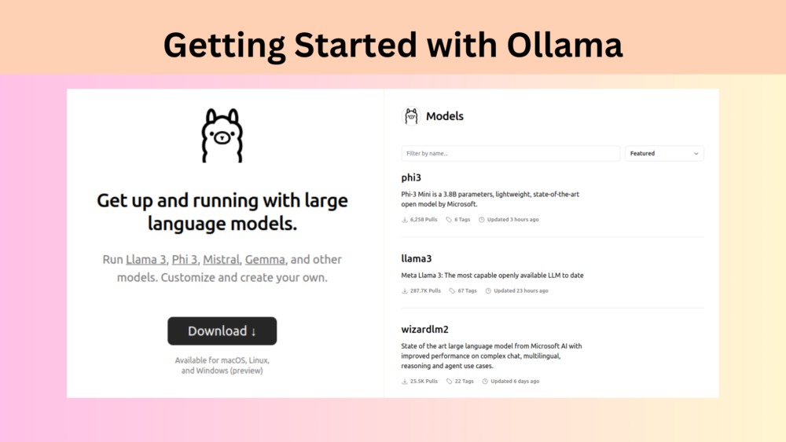
Ollama

Slide 35
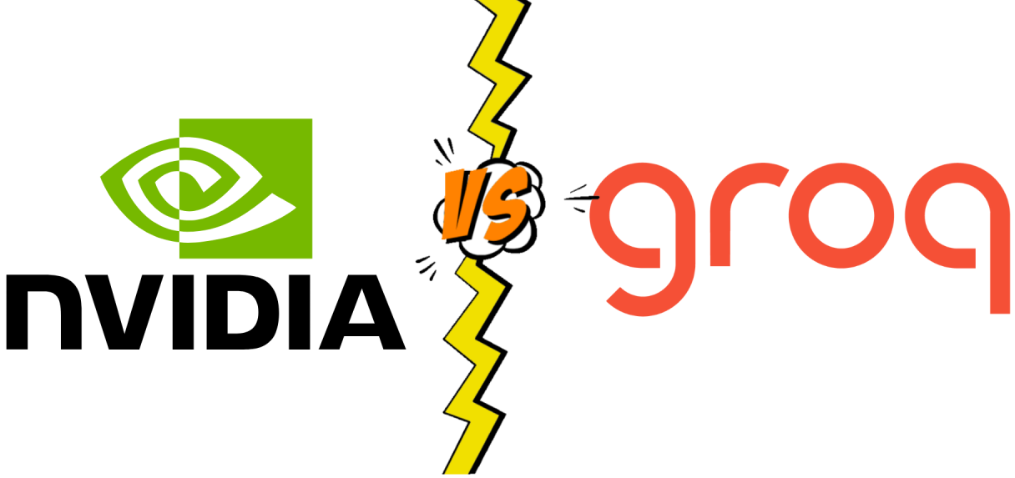
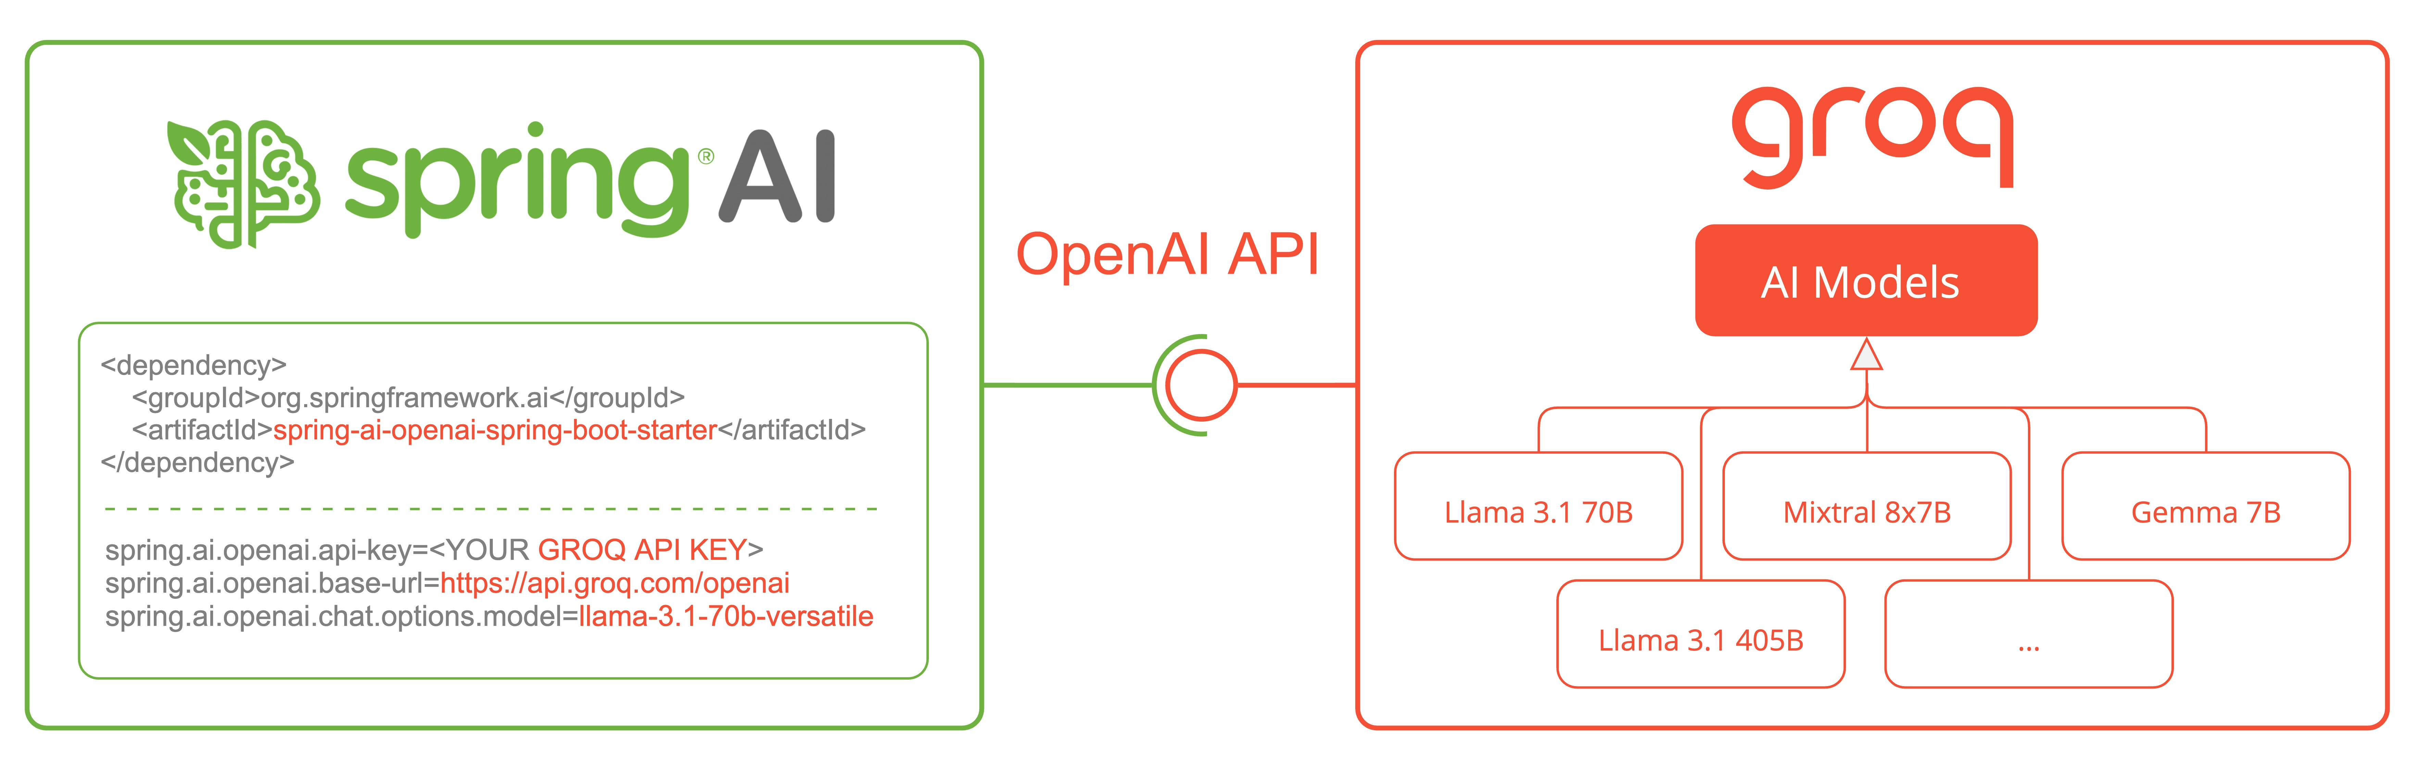
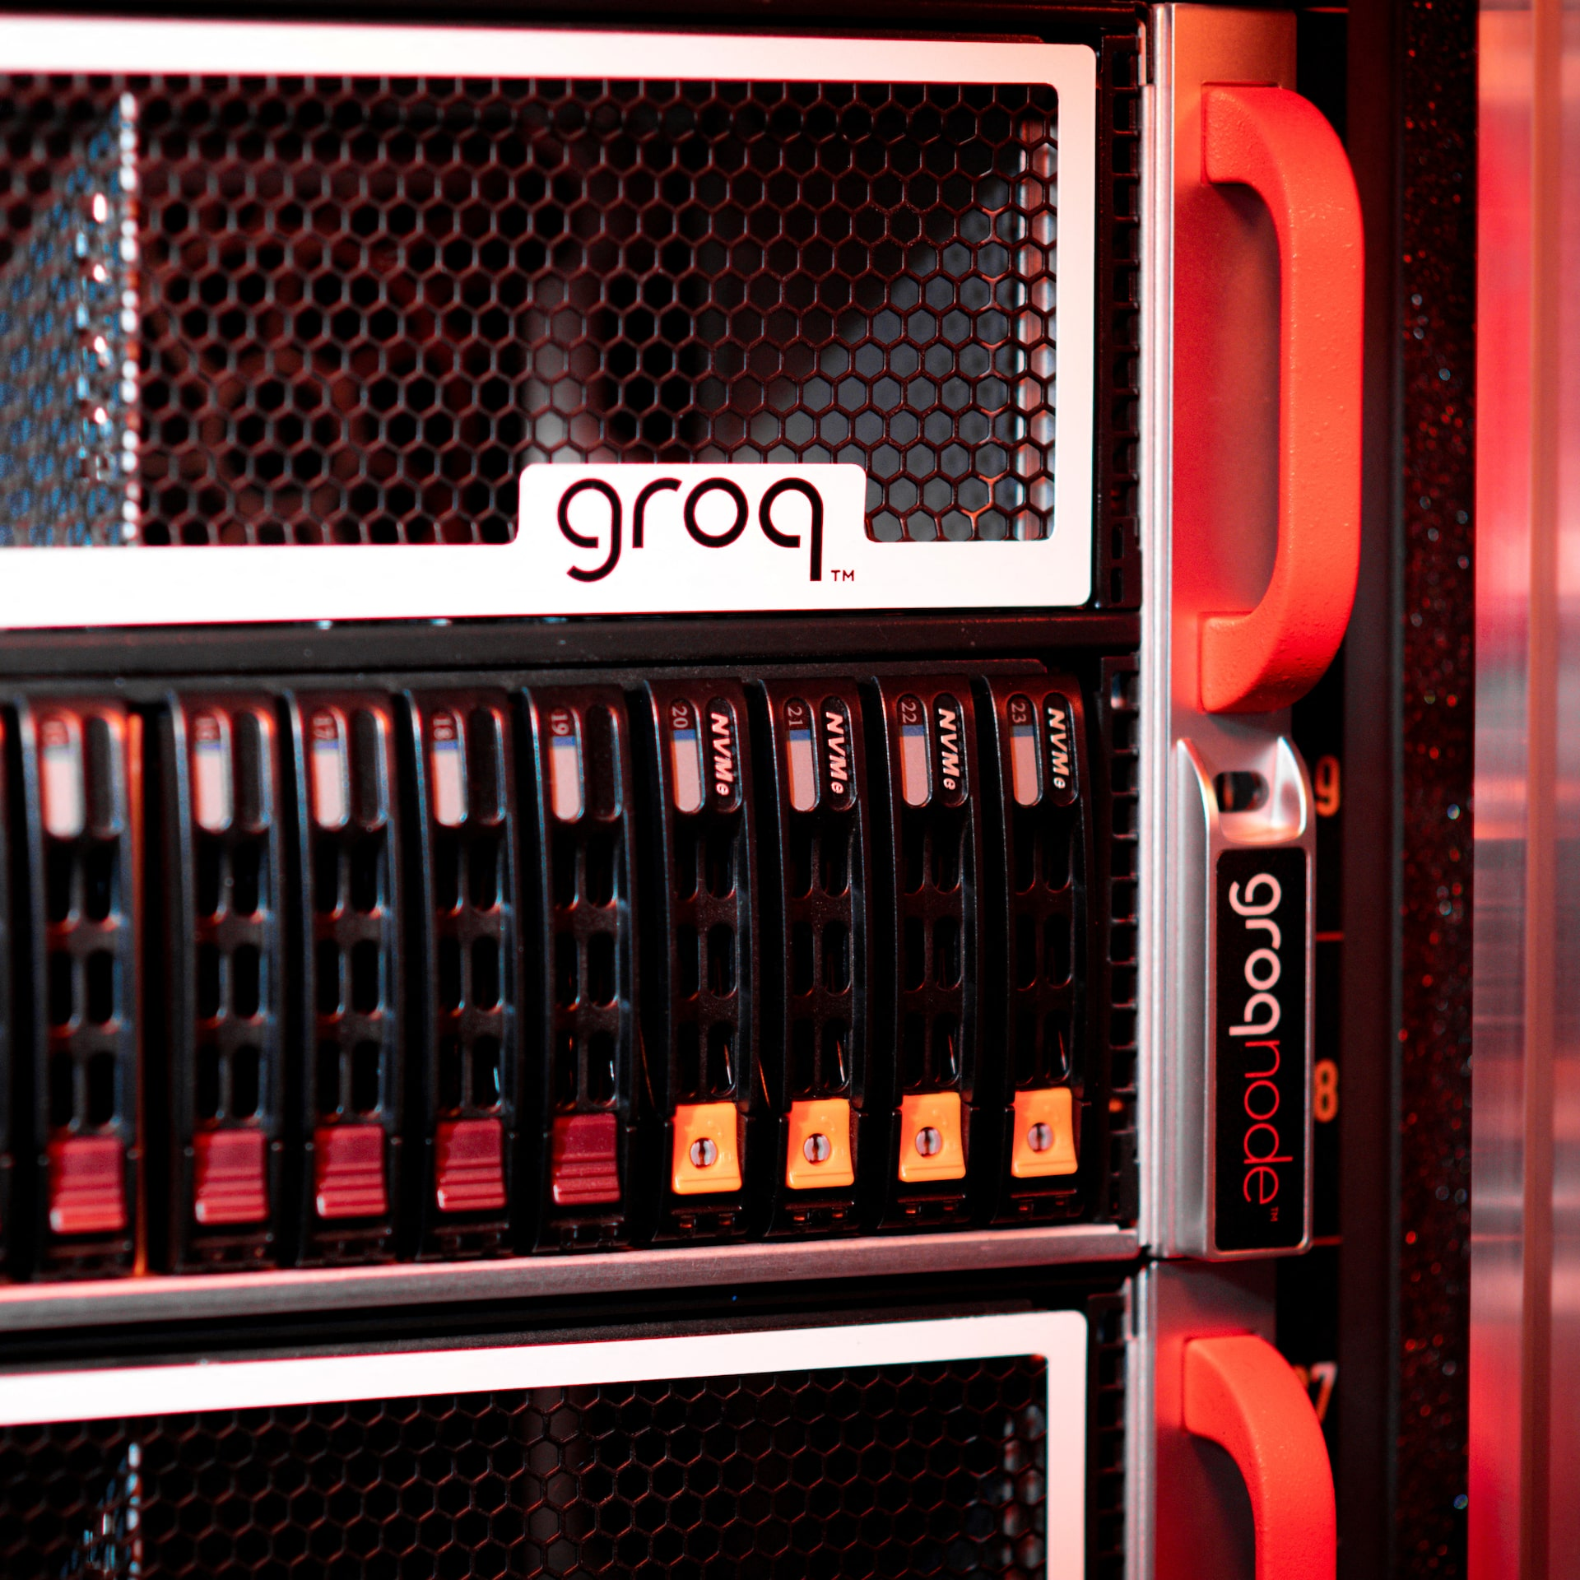
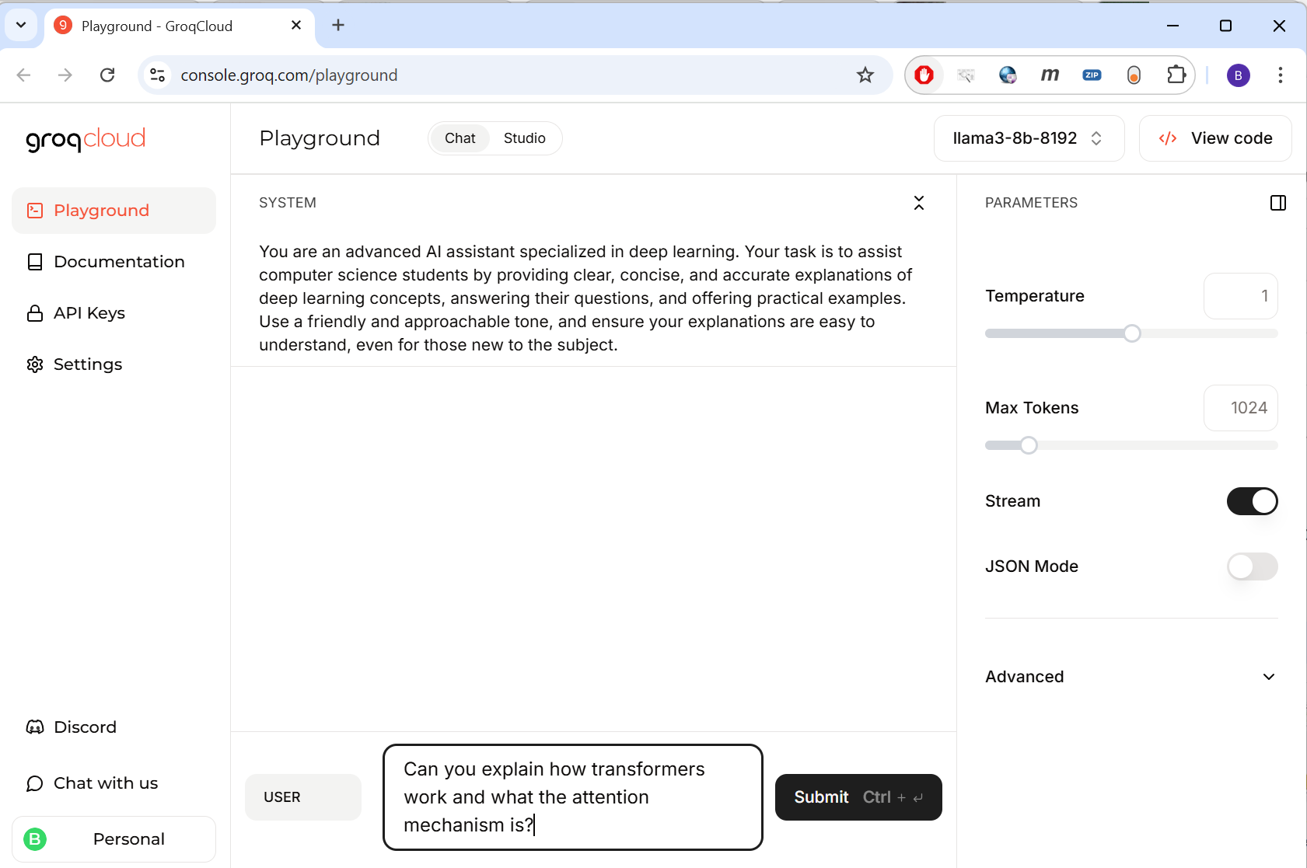
OpenAI API - Groq
Notes:
The OpenAI API is the original standard interface for using LLMs, while the Groq OpenAI API is a compatible version that lets you run open-source LLMs extremely fast on Groq hardware.

Slide 36
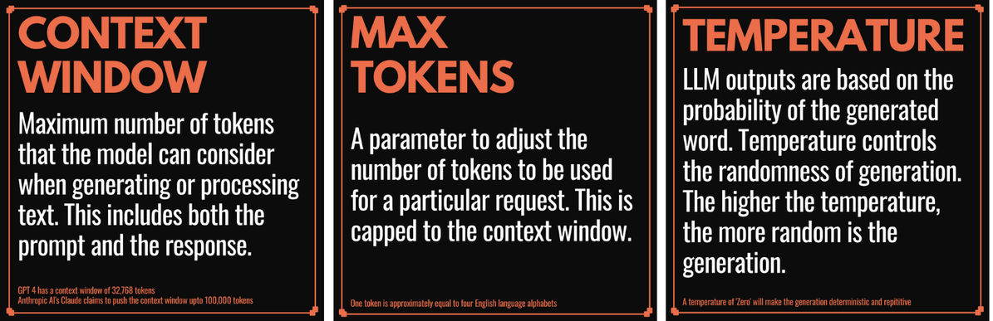
Common LLM Parameters
Notes:
https://www.linkedin.com/pulse/7-key-llm-parameters-everyone-designing-prompts-should-kimothi-rjcmc/

Slide 37
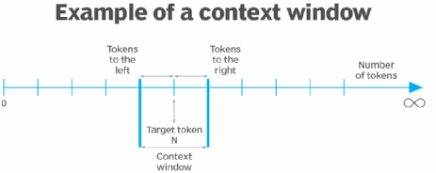
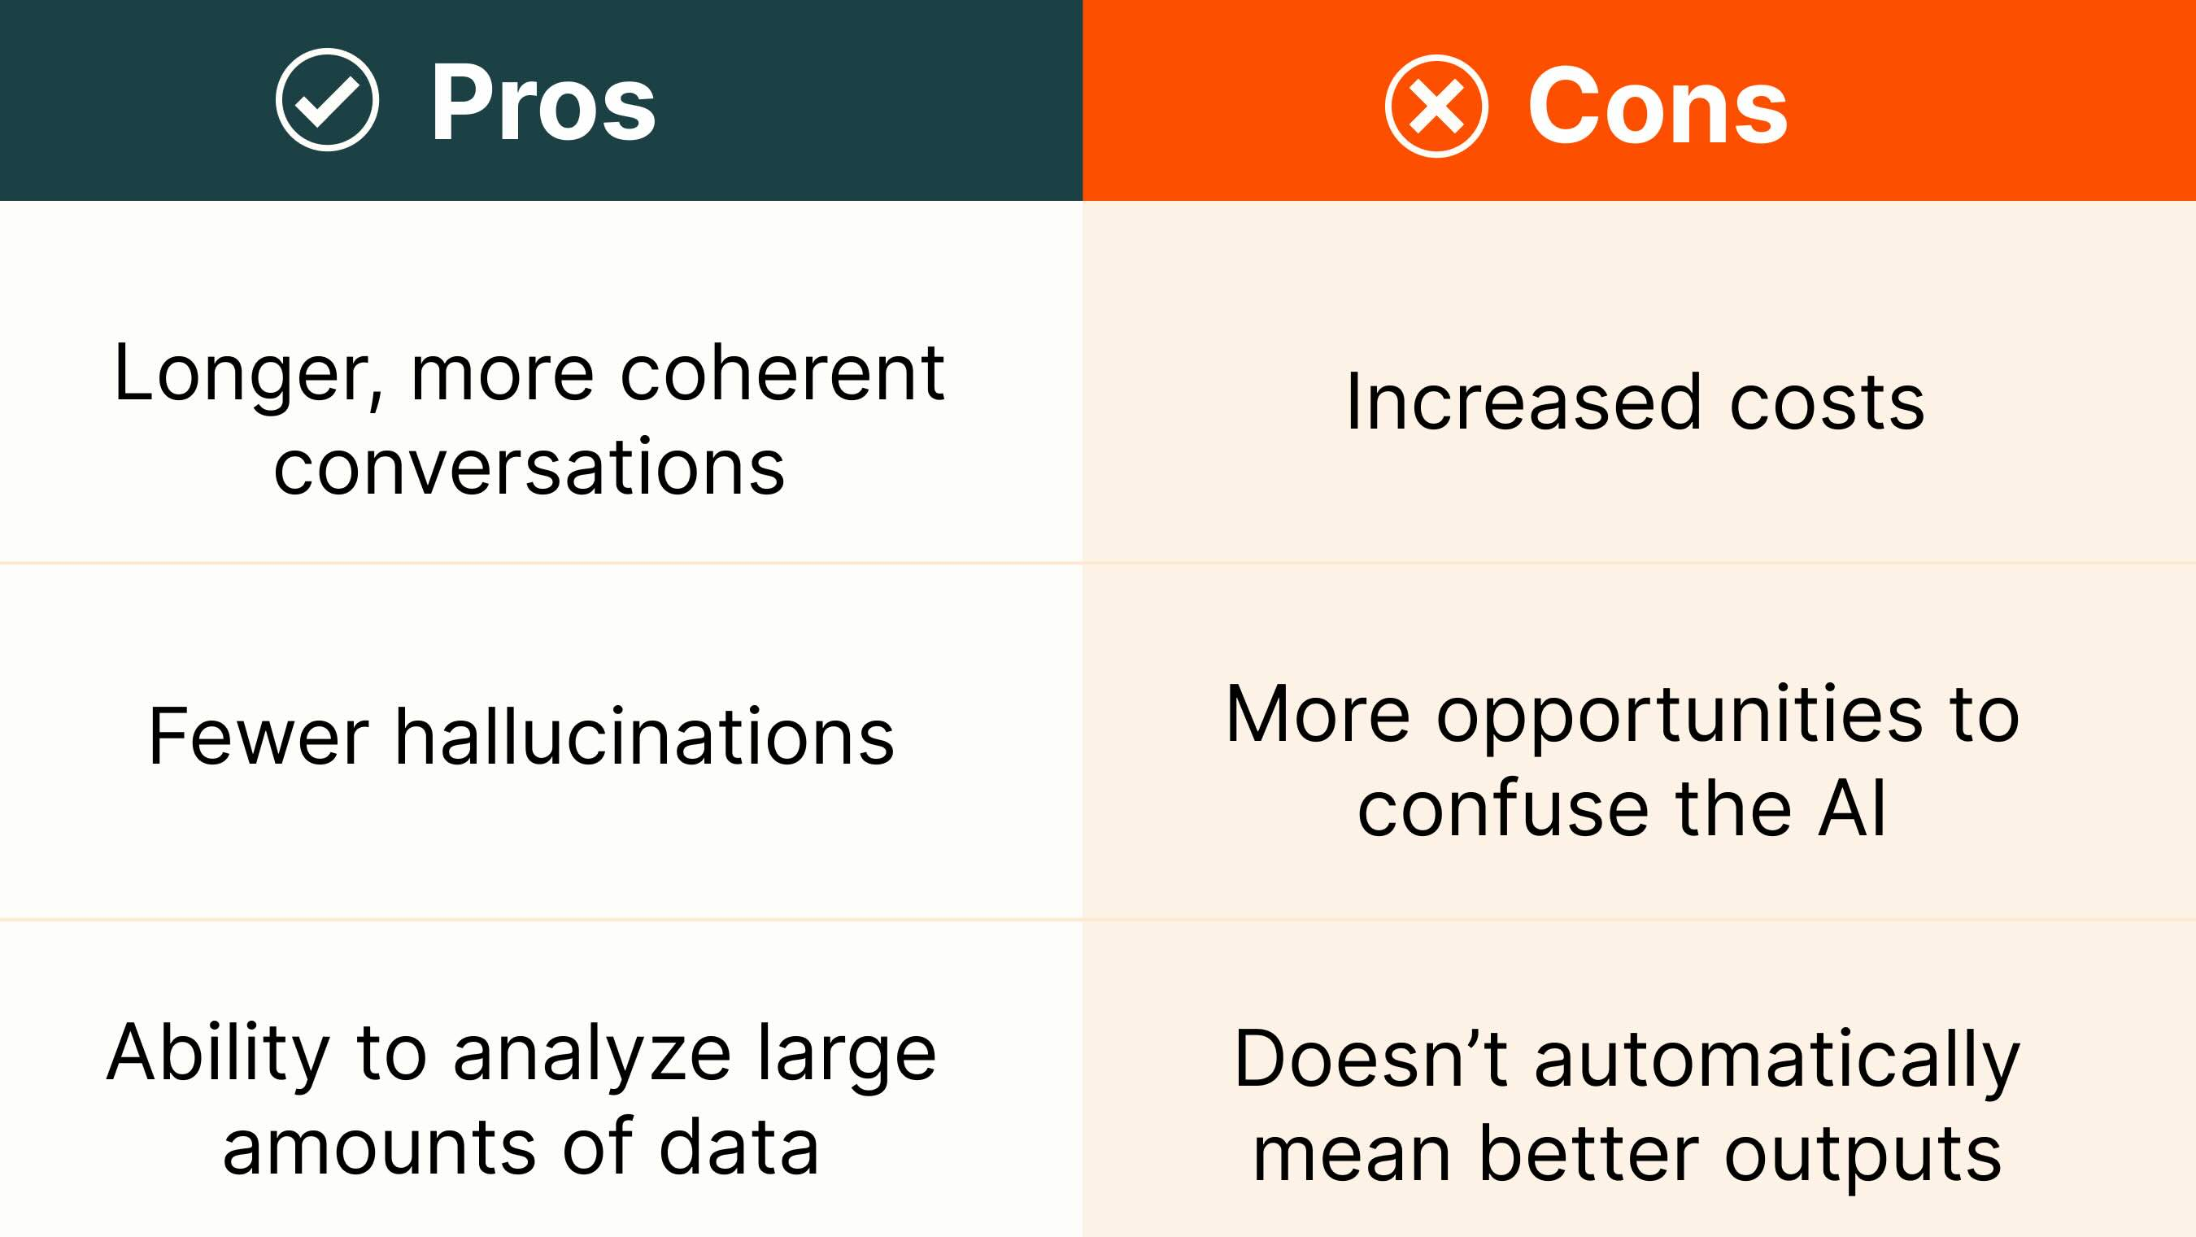
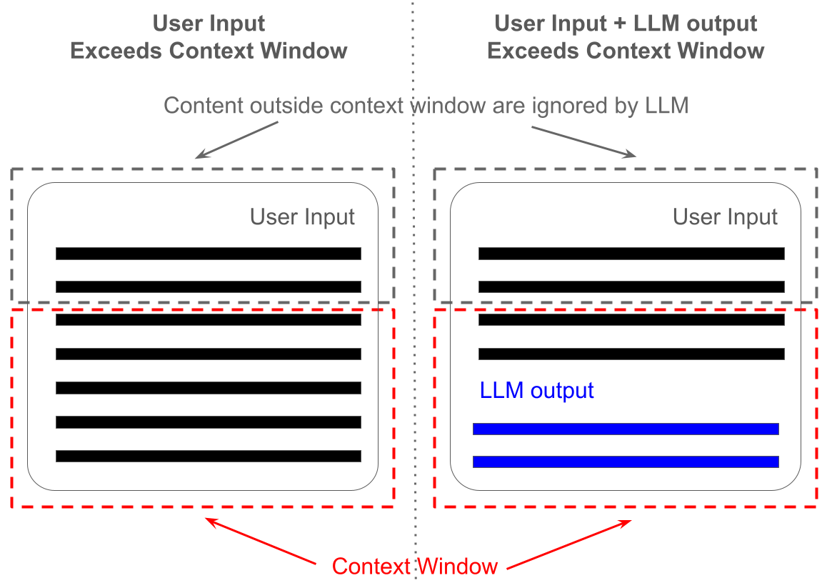
LLMs: (Bigger) Context Window
Context Window is the maximum number of tokens that the model can consider at one, including the prompt and response
Notes:
https://prompt.16x.engineer/blog/chatgpt-context-window-token-limit
https://www.techtarget.com/whatis/definition/context-window
The context window is the maximum amount of text (in tokens) the model can consider at once — including the prompt and its own generated output. Within this window, the model keeps track of the conversation and relationships between words. If the input + output exceed the window size, the oldest tokens drop out — the model “forgets” them.

Slide 38
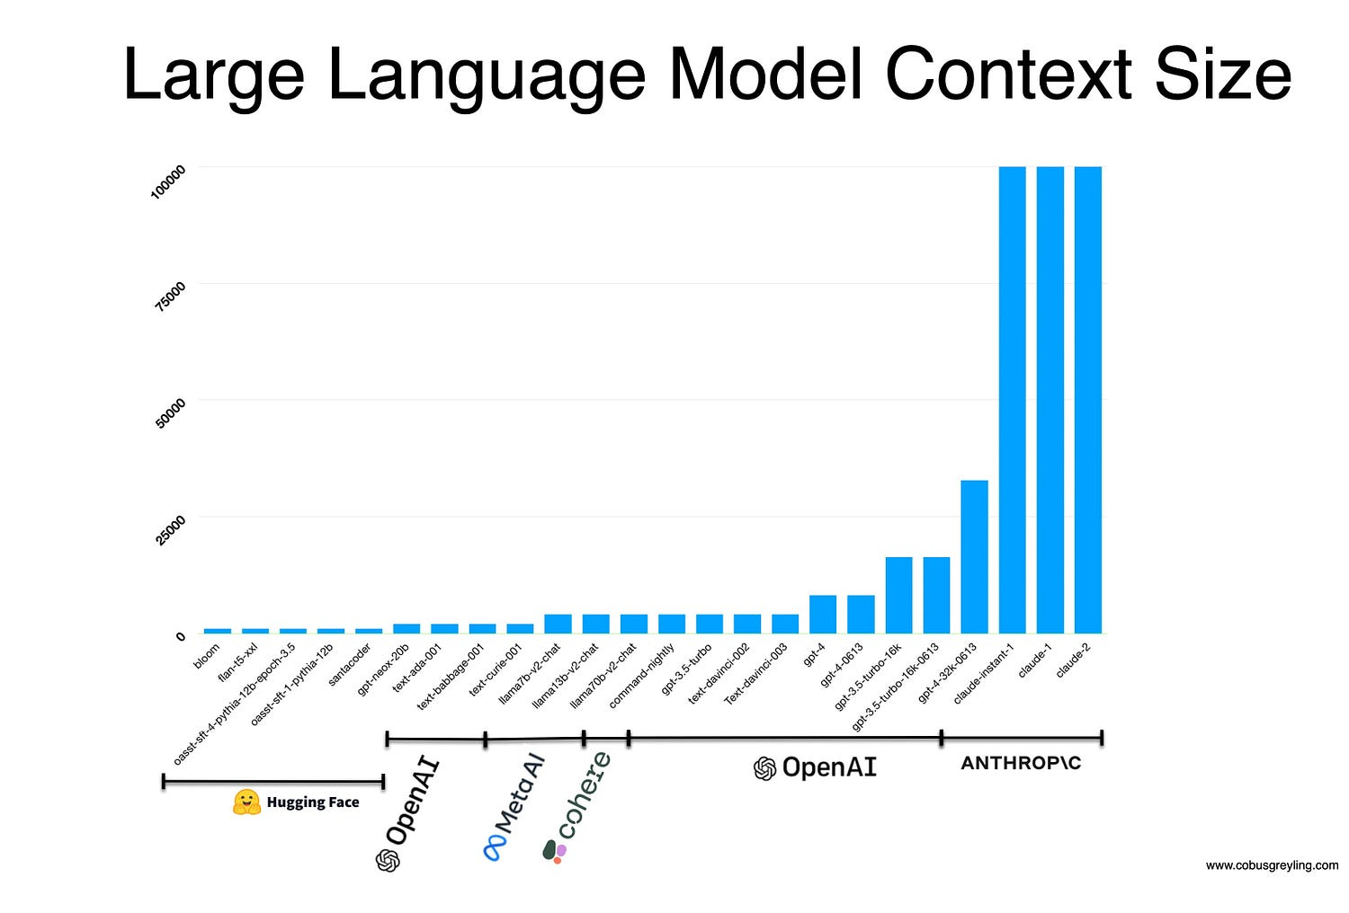
Notes:
GPT‑4 Turbo (16K version) =16,000 tokens: ~12,000 words, ~24 pages
Claude 2 (and other Claude 200k-token models) = 200,000 tokens: ~150k words, ~300 pages

Slide 39
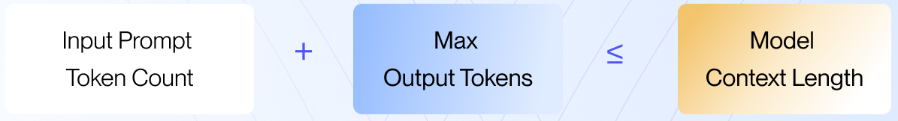
LLMs: Max Tokens
Max Tokens specifies the maximum number of tokens that can be generated in one response
Max Tokens is part of the ContextWindow:
Notes:
Max tokens is the limit on how much text the model is allowed to generate in one response.
It’s part of the total context window: prompt tokens + output tokens ≤ context window size
Setting a higher max token limit allows for longer answers, but if the prompt is already long, the available space for output shrinks.

Slide 40
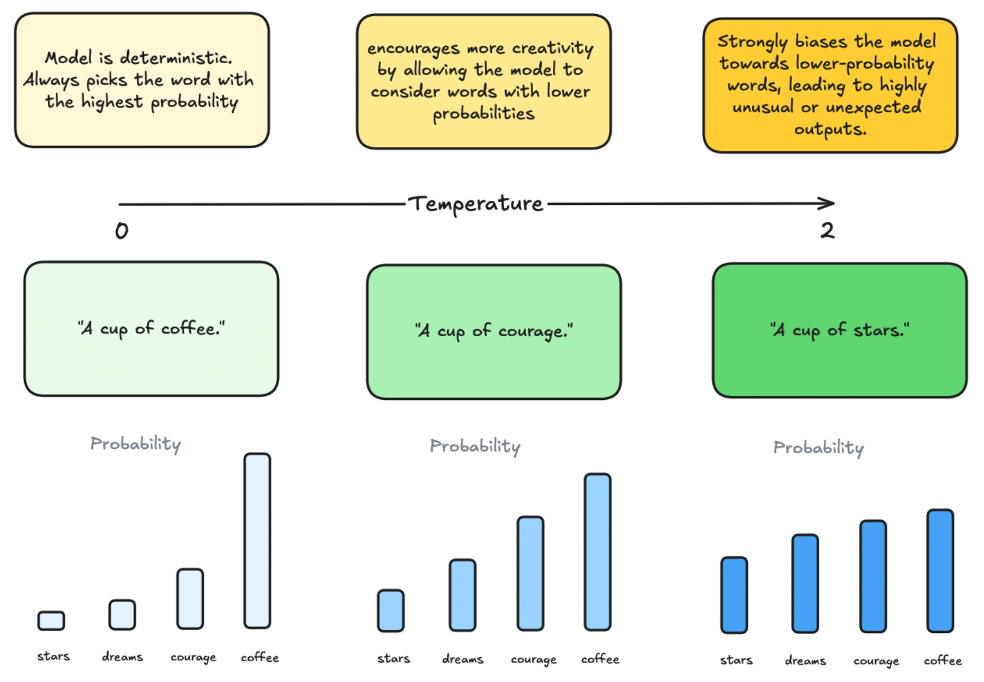
LLMs: Temperature
Temperature controls the randomness of word choice when generating text
Mathematically, it scales the probabilities of the next token
Conceptually, it changes creativity vs. consistency
Notes:
https://www.bighummingbird.com/blogs/llm-hyperparameter
Temperature controls the randomness of word choice when the model generates text.
Mathematically, it scales the probabilities of the next token — but conceptually, it changes creativity vs. consistency.

Slide 41
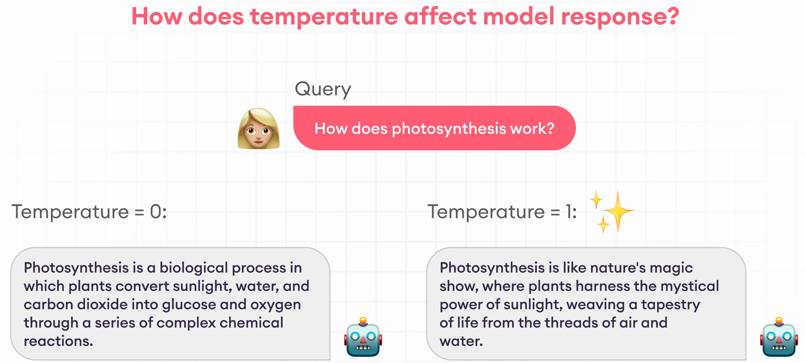
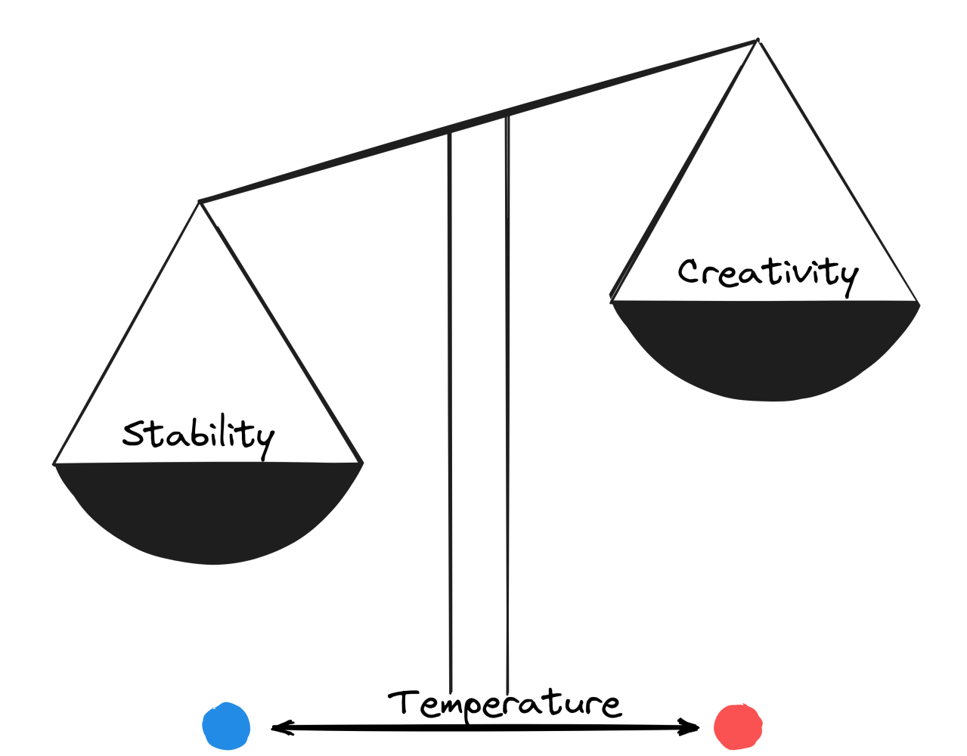
LLMs: Temperature

Slide 42
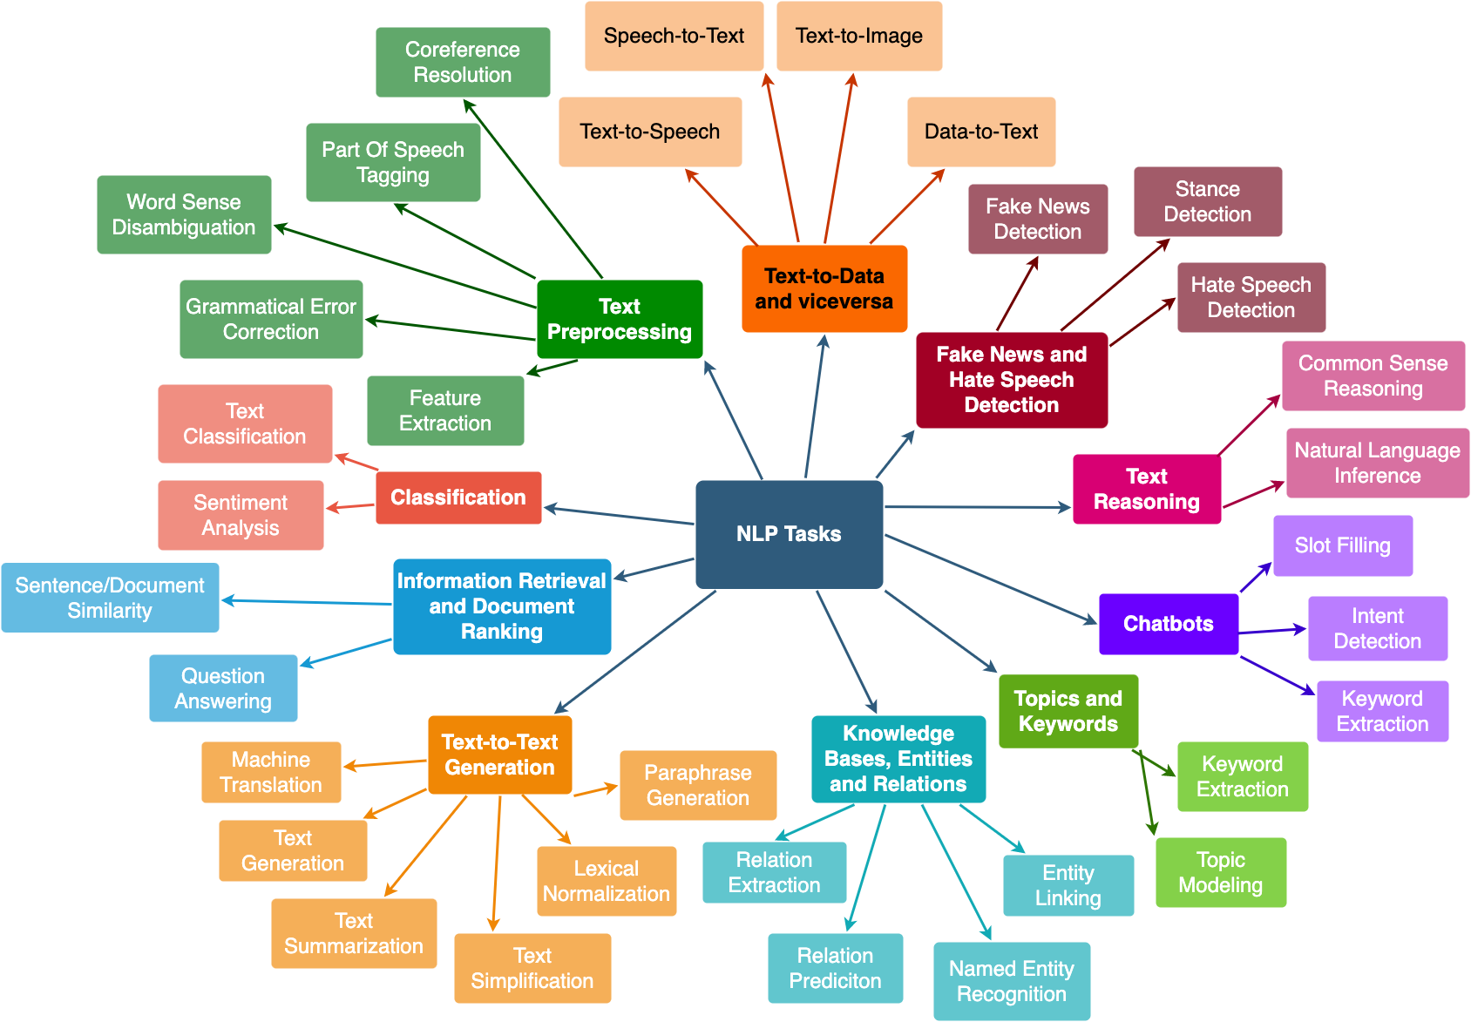
Use of a pre-trained LM
The three classical strategies for using a pre-trained LM on downstream NLP tasks:
Fine-tuning
Feature-based
Prompting
Notes:
https://www.nlplanet.org/course-practical-nlp/01-intro-to-nlp/02-nlp-tasks
Overview of downstream NLP tasks

Slide 43
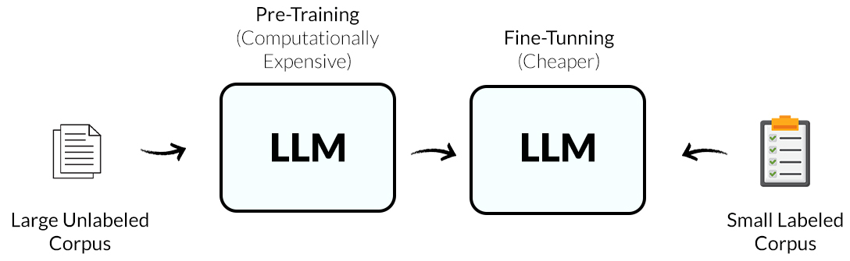
Fine-tuning
Fine-tuning means teaching the pre-trained LM the downstream NLP task
The training of the pre-trained model is continued on a smaller, task-specific dataset
Requires significant computational resources
Requires (high quality) domain-specific labeled data
Notes:
Fine-Tuning — “Teach it the specific task”
Definition: Continue training the pre-trained model on a smaller, task-specific dataset.
The model’s internal parameters are updated so it adapts to the new task
Requires labeled data and compute but yields high performance.

Slide 44
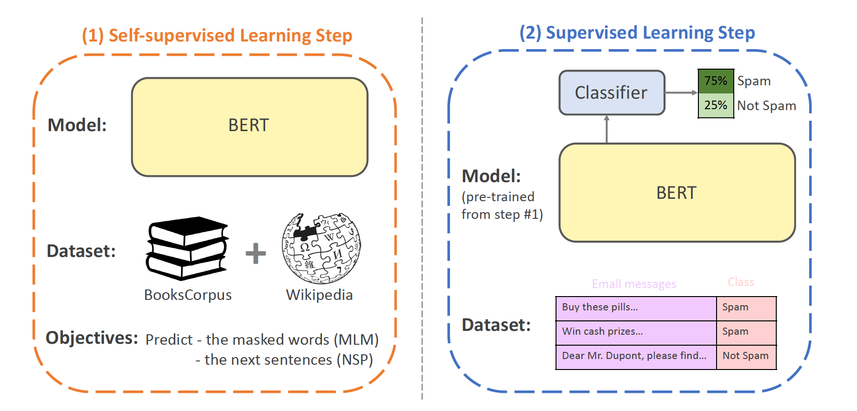
Fine-tuning
For a downstream task (e.g. spam detection):
Plug in the task-specific inputs and outputs
Add a simple output layer and its corresponding loss to the pre-trained model
Fine-tune all the parameters end-to-end for a few epochs

Slide 45
Feature-based
Feature-based means using the pre-trained LM as a feature extractor
Embeddings from the pre-trained model are used as input features for a separate model trained on the downstream task, while the LMs own parameters remain frozen
Allows a task-specific architecture
Useful when you have limited resources
Notes:
Feature-Based (or Embedding-based) — “Use it as a feature extractor”
Definition: Use the LM’s internal representations (embeddings) as features for another model, without changing the LM’s weights.
You “freeze” the LM and feed its outputs into a smaller classifier (e.g., logistic regression, MLP, SVM).
Useful when you have limited resources because you can use a smaller model
Example: Extract sentence embeddings from BERT → train a simple classifier on top for spam detection.

Slide 46
Prompting
Prompting means asking the pre-trained LM to do the downstream task in natural language
The pre-trained LM is not retrained, but the task is phrased as a prompt or instruction
The pre-trained LM leverages its broad knowledge to perform the task zero-shot or few-shot
Zero-shot: a prompt without examples
The model relies entirely on its pretrained knowledge
Few-shot: the prompt includes a few examples
The model infers the pattern from these examples This ability is called in-context learning
Notes:
Prompting — “Ask it to do the task in natural language”
Definition: No retraining — you simply phrase your task as a prompt or instruction in text form.
The pre-trained model leverages its broad knowledge to perform tasks zero-shot or few-shot.
Common with instruction-tuned LLMs (like GPT-4, Claude, Gemini).
Example: Prompt: “Classify the sentiment of this review as positive or negative: ‘The movie was fantastic!’” → Model outputs: “Positive.”

Slide 47
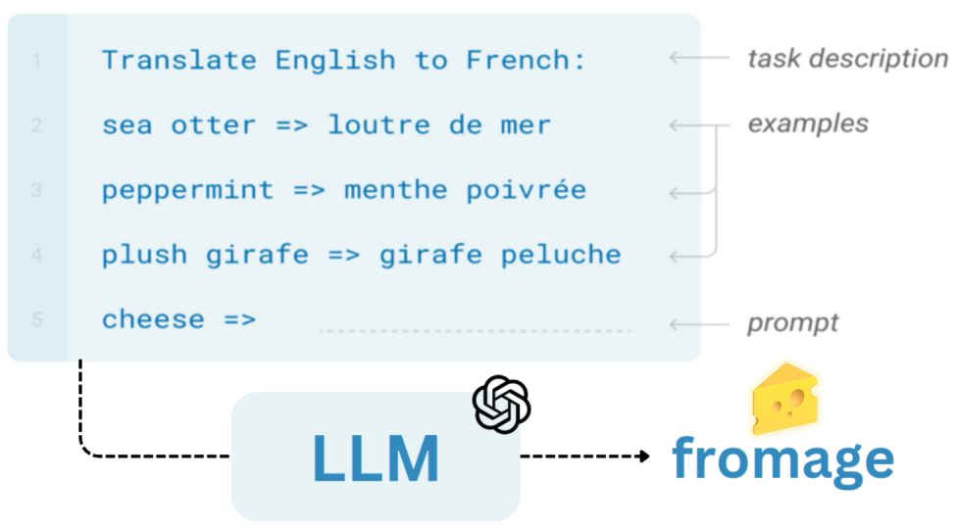
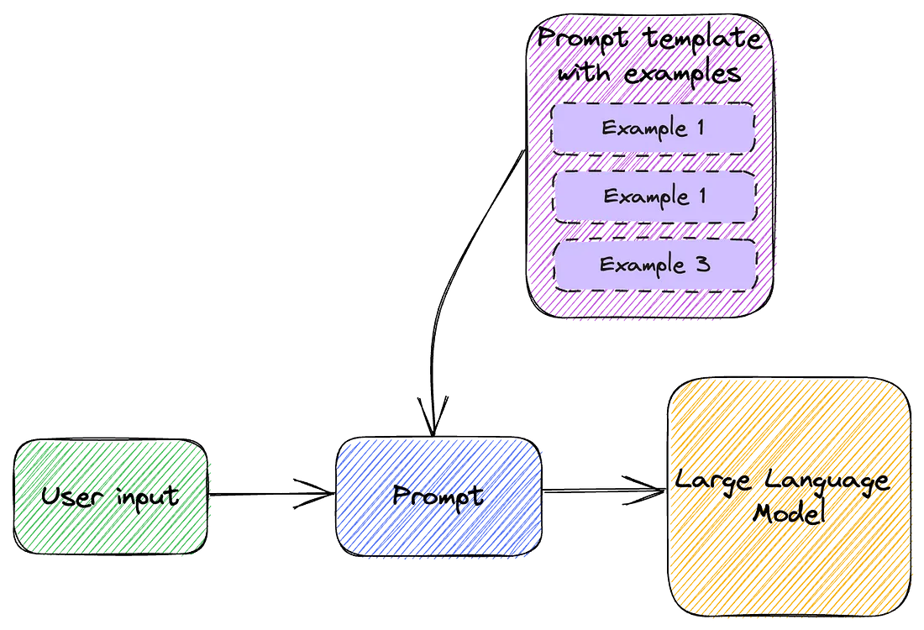
In-context learning ‘Few-shot’ learning → no parameter updates
In addition to the task description, the model sees a few examples of the task:
Notes:
https://www.linkedin.com/pulse/whats-in-context-learning-deep-why-its-so-cool-yacine-mahdid--lvgne/

Slide 48
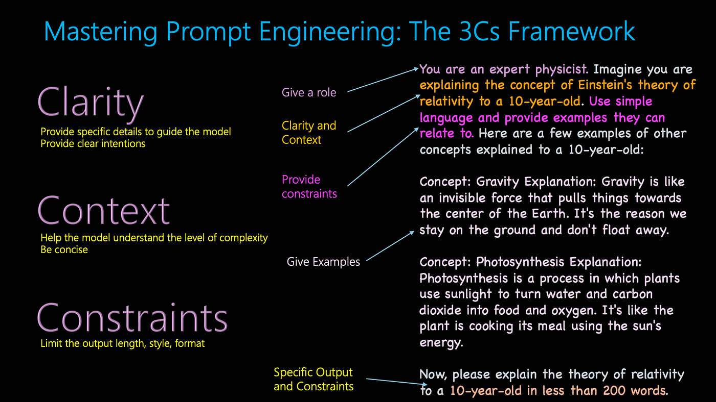
Notes:
https://www.linkedin.com/pulse/mastering-generative-ai-interactions-guide-in-context-pradeep-menon/

Slide 49
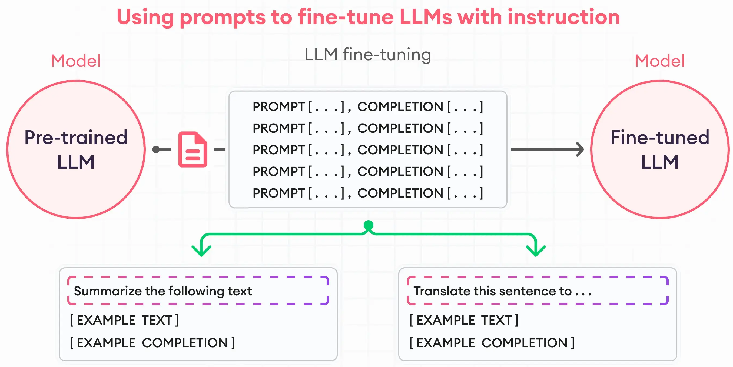
New strategies in the LLM era
Notes:
https://www.superannotate.com/blog/llm-fine-tuning
Form of fine-tuning, prompt-based fine-tuning or instruction tuning
The model is trained on a large dataset of prompt–response pairs, where the prompts are instructions written in natural language.
Goal: make the model better at following human-style instructions.

Slide 50
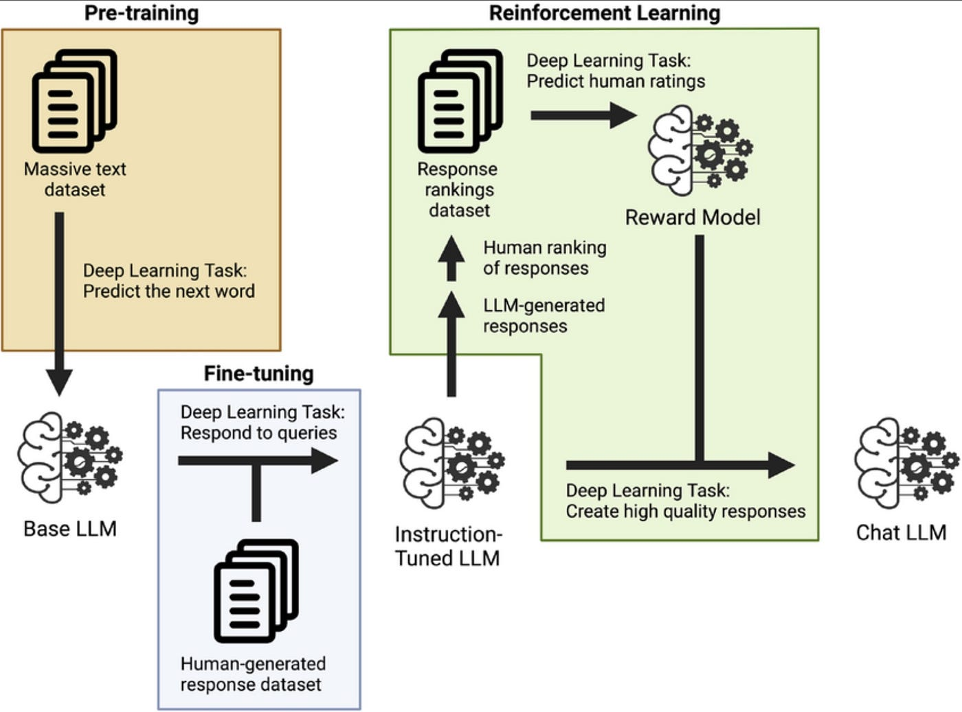
New strategies in the LLM era
Notes:
Reinforcement Learning from Human Feedback (RLHF)
Builds on instruction tuning.
Human evaluators rank or score model responses to prompts.
A reward model is trained on those rankings, and the base model is fine-tuned to maximize that reward using reinforcement learning

Slide 51
Retrieval Augmented Generation
RAG

Slide 52
Why do we need RAG?
LLMs have three major limitations that RAG helps solve:
LIMITATIONS
Knowledge cutoff
Hallucinations
Domain specificity
DESCRIPTION
LLM only knows data up to its last training date
LLMS makes up facts confidently
LLM might not have specialized company or domain knowledge
RAG SOLUTION Retrieves up-to-date info from external sources Grounds LLM responses in retrieved, factual text
Allows retrieval from internal documents, manuals, papers, etc.
Notes:
External sources (documents, databases, web)

Slide 53
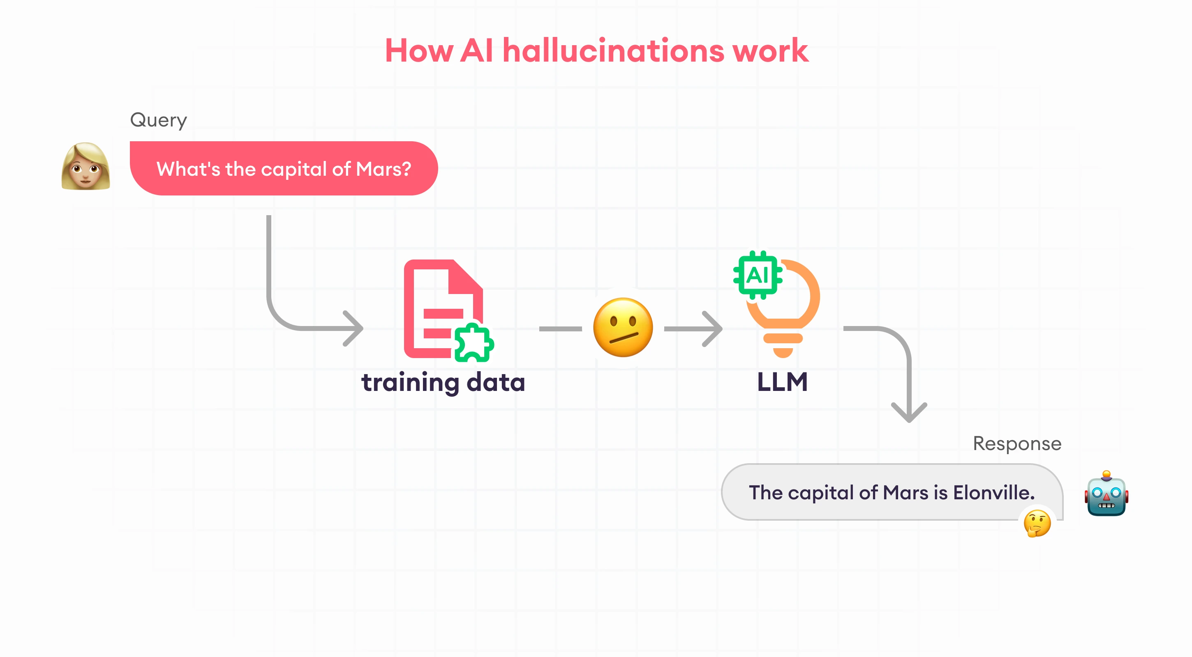
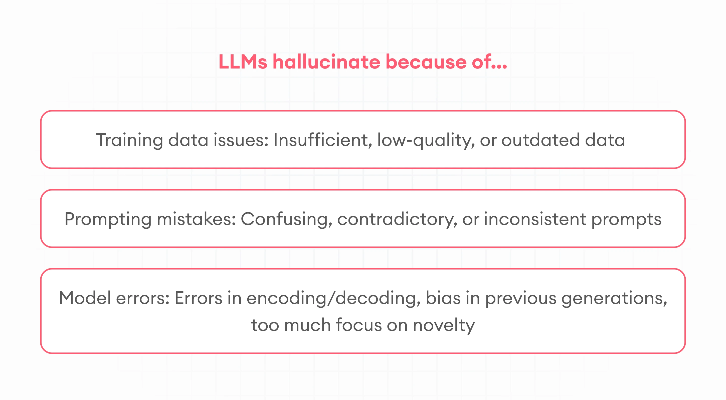
LLMs come with challenges
Hallucinations occur when an LLM produces text that is incorrect or made up but sounds convincing
They result from the model’s reliance on learned language patterns, not factual knowledge
LLMs are trained to predicts what looks plausible, not what is true
Notes:
https://www.superannotate.com/blog/ai-hallucinations
Hallucinations in large language models refer to instances where the model generates text that is factually incorrect, logically inconsistent, or entirely fabricated, even though it appears fluent and plausible. These arise because LLMs generate responses based on statistical patterns learned from text data rather than on verified facts or real-world understanding. As a result, they may confidently produce information that sounds correct but lacks grounding in truth or evidence.

Slide 54
What is RAG?
RAG (Retrieval-Augmented Generation) is a method that combines:
An LLM which generates natural-language responses
A retrieval system which searches for relevant, factual information
RAG is a combination of an LLM and external knowledge search in order to ground responses in retrieved, factual information instead of relying only on memory
RAG lets LLMs “read before they write”
Notes:
Relevant, factual information from external sources and internal sources
Instead of relying only on what the model “remembers” from pretraining, RAG allows it to look up information in real time and use that information to generate its response.

Slide 55
When do we need RAG?
RAG is used whenever:
The task requires factual accuracy or real-world knowledge
The needed information is not in the model’s parameters
You want to avoid retraining or fine-tuning a large model
Notes:
RAG makes LLMs factual, up-to-date, and domain-aware without retraining.
RAG is ideal when you want a general-purpose model to know specific or new information without retraining it.
Real-world knowledge that needs to be up to date
Typical applications:
Chatbots with company knowledge (e.g., HR or legal assistants)
Customer support systems (retrieving FAQs, manuals)
Search and summarization tools (document Q&A)

Slide 56
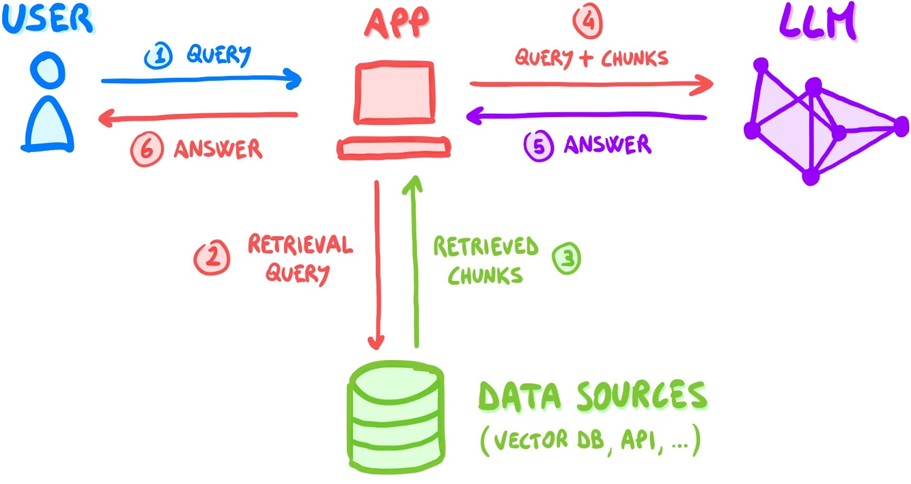
RAG Pipeline: ’10,000-foot view’
RAG = augmenting the query by adding custom / domain knowledge
Step 1-3: Retrieval
Step 4-6: Augmented generation
Notes:
Retrieval (1-3)
User asks a question, i.e. the query
The embedding model converts the query into a vector and the system searches for the most similar document vectors in the vector database = semantic search
3) The top-k relevant chunks are retrieved
Augmented generation (4-6)
4) The retrieved text chunks are appended to the prompt sent to the LLM
5) The LLM reads the context and generates a grounded answer, citing or summarizing the retrieved content
6) The system outputs an answer grounded in the retrieved context

Slide 57

RAG Pipeline: ‘Helicopter View’
Notes:
2) Embedding models (OpenAI, Cohere, SentenceTransformers)
3) Vector similarity (Dot product, cosine similarity, euclidean distance), Retrieval strategy (Precision vs recall)
4) Context window size (How much of retrieved text fits into LLM prompt)
The LLM “conditions” on the retrieved context during generation.
This can be through:
Naïve concatenation (stuff all chunks into the prompt).
Summarized context injection (compress before passing to the model).
Citation-aware prompting (ask the model to cite sources).
Common prompt patterns:
“Answer only using the context below.”
“Cite document IDs when answering.”

Slide 58

RAG Pipeline: Ground-Level view (out-of-scope for this course – active research domain)
Notes:
The Future of RAG: Interesting research directions
Adaptive retrieval: models decide when and what to retrieve dynamically.
Compression & summarization: improving long-context efficiency.
Multimodal RAG: integrating text, image, and structured data retrieval.
Graph-based RAG: connecting documents via knowledge graphs.
Neural search + RAG convergence: retrieval and generation co-trained end-to-end.

Slide 59

Data Orchestration Framework: LlamaIndex
Notes:
Ingest and prepares your data
Builds indices
Takes care of query processing

Slide 60
RAG: Challenges and Limitations
CHALLENGES
Context overflow
Retrieval noise
Embedding drift
Citation correctness
Latency & cost
Evaluation difficulty
DESCRIPTION
Retrieved context exceeding LLM’s window
Misleading irrelevant chunks
Different embedding models give inconsistent results
Model citing wrong sources
Expensive real-time embedding & retrieval
Hard to measure factuality
C

Slide 61
Vector Databases

Slide 62
Vector Database
A vector database allows to store and search document embeddings in RAG systems
They are created by:
Collecting knowledge sources
Splitting them into small chunks
Using an embedding model to create embeddings for each chunk
Storing them in a vector database
Building an index for fast search
Notes:
Collect your knowledge sources (documents, reports, PDFs, websites).
Split them into small chunks (e.g., 200–500 words)
Use an embedding model (like OpenAI’s text-embedding-3 or SentenceTransformers) to create vector embeddings for each chunk.
Store them in a vector database (e.g., Pinecone, FAISS, Weaviate).
Without an index, you’d have to compare a new query to every single vector — far too slow.

Slide 63

Vector Database
Stores data as embedding vectors (embedding depends on the LLM model)
Returns ‘top k’ embedding vectors, most like the query (neighbors)
Notes:
Each piece of text, image, or audio is represented as a vector.

Slide 64
Vector Database
A vector database looks up relevant information through semantic search:
Instead of relying on exact matches or keyword overlap as in traditional databases, they use vector similarity to find text that means the same thing, not just uses the same words
It matches the user query embedding with chunk embeddings to retrieve the most relevant chunks
This allows LLMs to answer questions factually
Notes:
Traditional databases (SQL, Elasticsearch, etc.) rely on exact matches or keyword overlap. But in NLP “dog” and “puppy” have similar meanings, though different words.
You need semantic search — find text that means the same thing, not just uses the same words.
That’s what vector databases enable.

Slide 65



Compute Similarity & Semantic Search
Notes:
Each piece of text, image, or audio is represented as a vector — a point in an embedding space.
Instead of using keywords (like in traditional databases), it uses vector similarity (cosine, dot product, etc.) to find related content.
Hence, instead of searching by exact words a vector database is searching by meaning.
The database indexes these vectors so you can quickly retrieve those that are closest to a given query vector.
Exact similarity search is too slow for large datasets (millions of vectors). Approximate Nearest Neighbor Search speed this up by approximating the search — trading a tiny bit of accuracy for huge performance gains. That’s how vector DBs achieve real-time semantic search at scale. Instead of checking every shelf in the library, the database jumps to the most promising sections first.

Slide 66

Common VectorDBs
Notes:
https://thedataquarry.com/posts/vector-db-1/
https://github.com/facebookresearch/faiss

Slide 67
Model Context Protocol
MCP

Slide 68

Model Context Protocol
Model Context Protocol (MCP) is an open standard by which LLMs or AI agents can access external data sources, tools and services in a uniform way
MCP defines how an LLM communicates with external systems to retrieve, use, and update context dynamically
Notes:
RAG gave LLMs access to external knowledge. MCP extends that: giving models access to external tools, data, and memory through a shared protocol.
With MCP, all LLMs and external systems use a common language, while before all these interactions were hard-coded.
All external resources (e.g., RAG vector stores, Github, Google Drive) look the same to the LLM.
The LLM knows what it can do (available actions) and how to do it (through structured interfaces).
The protocol addresses the issues caused by fragmented data integration by offering developers a cohesive architecture across MCP servers and clients, along with pre-built connectors for popular systems such as Google Drive and GitHub.

Slide 69

MCP Architecture
Notes:
MCP Host =The environment where the LLM runs (Claude App)
MCP Client = The language model or agent (Claude LLM)
MCP Server = The translator and gateway to an external tool
1) The LLM (MCP Client) sends a request like: “Search for documents related to climate change in the company knowledge base.”
2) The MCP Host receives the request and looks up which MCP Servers are connected and what actions they provide (e.g., search_documents()). 3) The Host forwards this structured request to the right MCP Server.
4) The MCP Server translates the abstract action (search_documents()) into the tool’s native API language (e.g., a Pinecone or Weaviate query).
5) The external tool executes the request and sends results (e.g., top-k chunks).
6) The MCP Server wraps the results in standard MCP format and sends them back through the host to the LLM client.

Slide 70


Slide 71
Agentic AI
CrewAI

Slide 72

The rise of AI Agents
Notes:
RAG: retrieve relevant, factual context from external data sources to generate answers
AI agent: can retrieve, use and update context from many different types of tools, not only generate answers but also perform actions

Slide 73
Agentic AI
Agentic AI refers to AI systems or agents (often powered by LLMs) that can perceive, reason, act, remember and plan autonomously to achieve goals
An AI agent does not just generate text. It:
Decides what to do next
Uses tools or external data sources when needed
Remembers relevant information from past interactions
Plans multi-step actions towards a goal
Notes:
An AI becomes agentic when it gains the ability to:
Perceive → Understand its context (user goals, environment, available tools).
Reason → Decide which action or tool to use next.
Act → Execute that action (e.g., query a vector DB, call an API, write a file).
Reflect & remember → Incorporate feedback or memory to improve future behavior.
Plan → Plan multi-step actions towards a goal
This turns the model from a reactive generator into a proactive decision-maker

Slide 74

AI Agent: General Components
An AI agent typically integrates tools, memory and planning:

Slide 75
AI Agent: Tools
Tools are the external systems the AI agent can use to gather data or perform actions
E.g., a search engine, vector database, calculator, calendar, file system, Web API, code executor, email sender, …
Tools make the agent actionable: it is no longer limited to its pretrained knowledge or text generation
Tools are usually accessed via MCP servers which expose standardized actions the agent can call

Slide 76
AI Agent: Memory
A standard LLM only “sees” what is inside its context window: once the context is too long or the chat ends, earlier information is lost
To behave like an agent, an LLM needs memory to retain and recall relevant information
After each interaction or reasoning cycle, the agent saves what it has learned and done in two complementary forms:
The summary text (or reflection) is passed through an embedding model and stored in a vector database semantic memory for recall
The agent creates a structured record of its state, actions, and results and stores it in a database structured checkpoint for continuity
The structured checkpoint is linked to the reflection embedding, connecting the two forms of memory
Notes:
https://medium.com/@anil.jain.baba/long-term-agentic-memory-with-langgraph-824050b09852
Summary text: e.g., summary of a chat, a learned fact, …
Structured checkpoint is saved alongside its embedding
Summarize the relevant information
The agent extracts key data from the current reasoning cycle — e.g.:
What it learned
What actions it took
What the results were
Any reflections or insights
Create an embedding (vector representation)
The summary text (or reflection) is passed through an embedding model.
This produces a high-dimensional vector capturing the meaning of the memory.
This allows future semantic search (find “similar situations” or “related lessons”).
Attach metadata
The vector is stored together with structured metadata, e.g.:
Timestamp
Agent state or goal
Tags / task category
User or session ID
Confidence score or evaluation result
→ This metadata makes retrieval and filtering efficient.
Store the embedding in a vector database
The vector and metadata are saved in a vector store (e.g., Weaviate, Pinecone, FAISS).
This becomes part of the agent’s long-term semantic memory.
Later, when the agent faces a similar task, it embeds the new context and searches this database for related experiences.
Create a structured checkpoint
The agent also saves a structured record of the entire interaction:
goal_state — what it was trying to achieve
inputs — data or queries it used
actions — which tools or APIs it called
results — outputs or observations
evaluation — whether the step succeeded or failed
reflection — what it learned from the outcome
→ This checkpoint is stored in a database or document store (SQL, JSON, etc.).
Link the two forms of memory
The structured checkpoint is linked to its embedding (often by an ID).
This means:
The vector database can find relevant checkpoints via semantic search.
The agent can then fetch the full structured record to analyze or replay.

Slide 77
AI Agent: Memory
When the agent receives a new query, it embeds the input and retrieves relevant memories:
It searches the vector database for the most similar embeddings, i.e., past experiences or reflections with related meaning
It fetches the corresponding checkpoints to inspect what it did, why, and how it turned out
Retrieved memories are reinserted into the prompt, giving the model:
A sense of continuity across interactions
The ability to handle long-running tasks
Mechanisms for recovery from failure and self-improvement
Notes:
The embedding memory enables semantic retrieval: find relevant experiences, reflections, or similar contexts.
The structured checkpoint enables reconstruction and reflection: replay what the agent did, how it reasoned, and what it learned.
An advanced agent also:
Summarizes long histories to save space.
Clusters related memories to form higher-level knowledge.
Deletes or decays irrelevant data to stay efficient.
This mimics human forgetting and abstraction — keeping the important, discarding the trivial.

Slide 78
AI Agent: Planning
Implicit planning occurs when the agent reasons and plans within a single prompt, such as through chain-of-thought reasoning
There is explicit planning where the agent:
Decomposes a complex goal task into smaller steps
Decides which tools to use and in what order
Explicit planning is dynamic: the agent can revise or refine its plan after each step based on success, failure, or new information
Planning gives an AI agent autonomy
Notes:
Through planning an AI agent can take initiative/be proactive instead of being reactive

Slide 79

Notes:
https://www.dailydoseofds.com/p/rag-vs-agentic-rag/
This is not just RAG — it’s Agentic RAG: reasoning + retrieval + memory + planning.
Example: An Agentic RAG System in Action
Imagine a research assistant agent:
User: “Find the latest papers on AI ethics and summarize key debates.”
Agent reasoning (Planning):
Decide to query the “Research Papers” vector DB.
Use the RAG retrieval tool to fetch relevant documents.
Tool use (via MCP):
Calls search_documents() on the vector DB server.
Generation (LLM):
Reads retrieved text and writes a summary.
Memory update:
Stores the summary embedding for future reference.

Slide 80


Slide 81
Multi-Agent Systems
A multi-agent system (MAS) is a group of autonomous AI agents that collaborate to achieve complex goals
This mirrors real-world workflows and enables division of labor
Each agent has its own role, knowledge, tools, and reasoning, and they communicate to share results
MAS provide specialization, scalability, and parallelism, overcoming the limits of single-agent LLMs
Notes:
Agents can communicate, coordinate, and delegate tasks to one another.
Also overcoming the limit of limited context window and having to do all reasoning itself

Slide 82





Popular Agentic AI frameworks
Focus of this course
Notes:
CrewAI is a Python framework for building multi-agent LLM systems

Slide 83


CrewAI: Concept
Notes:
CrewAI is a framework that lets you define a crew of AI agents, assign them roles, and coordinate their work.
Together, they form collaborative AI teams capable of reasoning, planning, and executing multi-step workflows.

Slide 84

CrewAI: Crew, Agent, Task, Tools, Process
Notes:
Agent – an LLM with a role/goal/backstory and optional tools + constraints (e.g., “Researcher”, “Analyst”, “Writer”).
Task – a concrete piece of work assigned to an agent (with a clear description and expected output).
Crew – the group of agents + the set of tasks + the process (sequential, parallel, or hierarchical with a manager).
Tools – functions/APIs the agent can call (RAG retriever, web search, calculator, DB, code runner, file I/O…).
Process – how work flows: hand-offs, ordering, manager/critic loops, etc. (=Planning)
CrewAI is a Python framework for building multi-agent LLM systems: you define several specialized agents (roles), give them tasks, optionally wire in tools (RAG, web/APIs, code, files), and CrewAI coordinates their collaboration or process (hand-offs, sequencing, debate/critique) to produce a final result.

Slide 85


Slide 86

https://docs.crewai.com/

Slide 87



CrewAI: Agent
‘Old way’: agents.py file
‘New way’: /config/agents.yaml
Notes:
Create agents
Role, goal, backstory
Verbose, memory, allow_delegation

Slide 88

CrewAI: Task
Define Tasks
In tasks.py
Or, in config/tasks.yaml
Notes:
Define tasks

Slide 89


CrewAI: Crew
Default process: sequential
Notes:
Create the crew (agents, tasks, process) and run

Slide 90


CrewAI Agent: Chain-of-Thought & ReAct (Reasoning & Acting)
Notes:
https://towardsdatascience.com/navigating-the-world-of-llm-agents-a-beginners-guide-3b8d499db7a9
Chain-of-Thought (CoT)
The agent reasons step by step in natural language before deciding what to do.
ReAct (Reasoning + Acting)
The agent alternates between reasoning (“thinking”) and acting (“using tools or taking steps”).
CrewAI agents combine Chain-of-Thought (think before you act) with ReAct (reason while acting), enabling intelligent, goal-directed behavior.

Slide 91



CrewAI: Tools & Integrations
Commonly used tools:
Web search (Serper API), Groq API, YouTube and Media Connectors, Database connectors (SQLAlchemy, PyMongo), Langchain tools, AI Powered tools (DallE API), SeleniumWeb Scraping, LLamaIndex, Slack API, etc.

Slide 92


CrewAI: Process/Planning
Notes:
Two main Process types
Linear workflow vs Complex workflow where roles and planning evolve

Slide 93


CrewAI: Memory (Short- & Long-term)
Notes:
https://langchain-ai.github.io/langgraph/concepts/#langgraph
Short-term memory stores context within the current process or conversation
Long-term memory persists across runs or sessions
This memory is often stored as embeddings in a vector database, allowing semantic retrieval of relevant information when needed.
Together, short- and long-term memory give agents a sense of continuity, learning, and self-improvement over time.

Slide 94

CrewAI: Putting it all together

Slide 96
NLP Challenge
Personal Learning Assistant
Notes:
Students will design a personal learning assistant using CrewAI. The system should include a chat interface where users can ask questions, review materials, and receive feedback. Multiple agents (e.g., tutor, summarizer, quiz generator) should collaborate through CrewAI to support personalized learning. Each agent must have a clear role, defined goals, and use tools (e.g., RAG, notes, files) where relevant. The final assistant should demonstrate multi-agent reasoning, tool use, and context continuity across interactions.

Slide 97
Personal Learning Assistant
Platform
Use CrewAI, LangGraph, … to build a multi-agent personal learning assistant
Goal (MVP)
The assistant responds to user questions through a chat interface
Demonstrate multi-agent collaboration (at least two interacting agents)
Integrate at least one MCP tool (e.g., RAG search, web API, or document retriever)
Maintain short-term context continuity within a conversation
Produce useful educational outputs (e.g., summaries, explanations, or quizzes)
Possible Extra’s / Extensions / Extra credit
Experiment with additional tools or agent roles for richer collaboration
Add long-term memory using a vector database for persistent recall
Implement adaptive behavior where agents reflect and improve over time
Notes:
Students will design a personal learning assistant using CrewAI. The system should include a chat interface where users can ask questions, review materials, and receive feedback. Multiple agents (e.g., tutor, summarizer, quiz generator) should collaborate through CrewAI to support personalized learning. Each agent must have a clear role, defined goals, and use tools (e.g., RAG, notes, files) where relevant. The final assistant should demonstrate multi-agent reasoning, tool use, and context continuity across interactions.
Think about all parts of the lecture!
Prompting: Constraints (e.g., add a “constraints” section per agent (e.g., don’t fabricate citations; prefer primary sources)
Parameters: Temperature (set low temperature for fact-heavy tasks, higher for ideation)
Read CrewAI manuals (learning concepts, good practices)!
Use AI tools!

Slide 98



Over to you

